Slide 1
Work Progress
By: Abdur Rehman

Slide 2
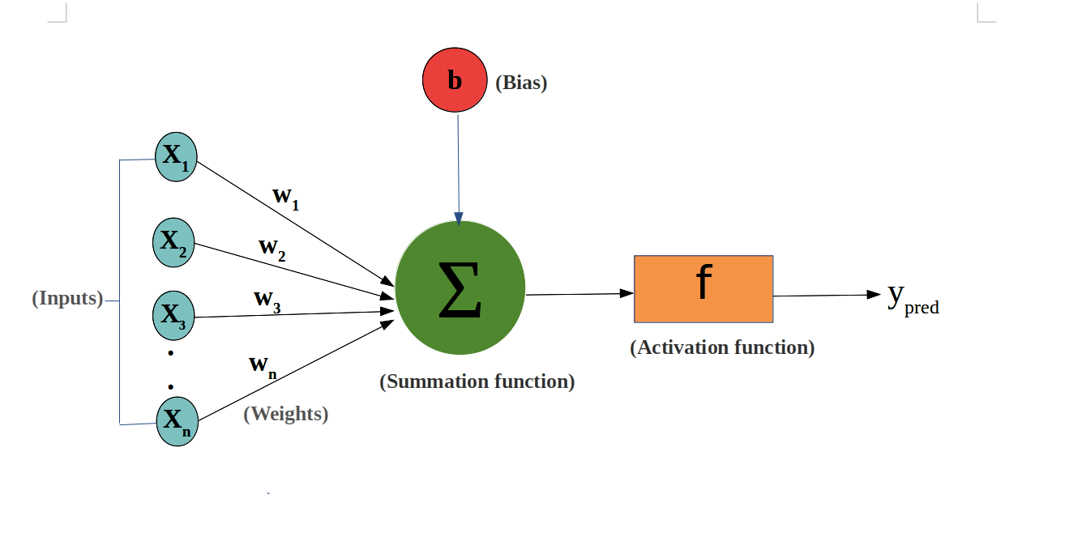
Regularizers in Keras
kernel_regularizer: Regularizer to apply a penalty on the layer's kernel
bias_regularizer: Regularizer to apply a penalty on the layer's bias
activity_regularizer: Regularizer to apply a penalty on the layer's output
Regression equation “y=Wx+b”;
where x is the input,
y is output,
W the weights matrix (also called kernel),
and b the bias.

Slide 3
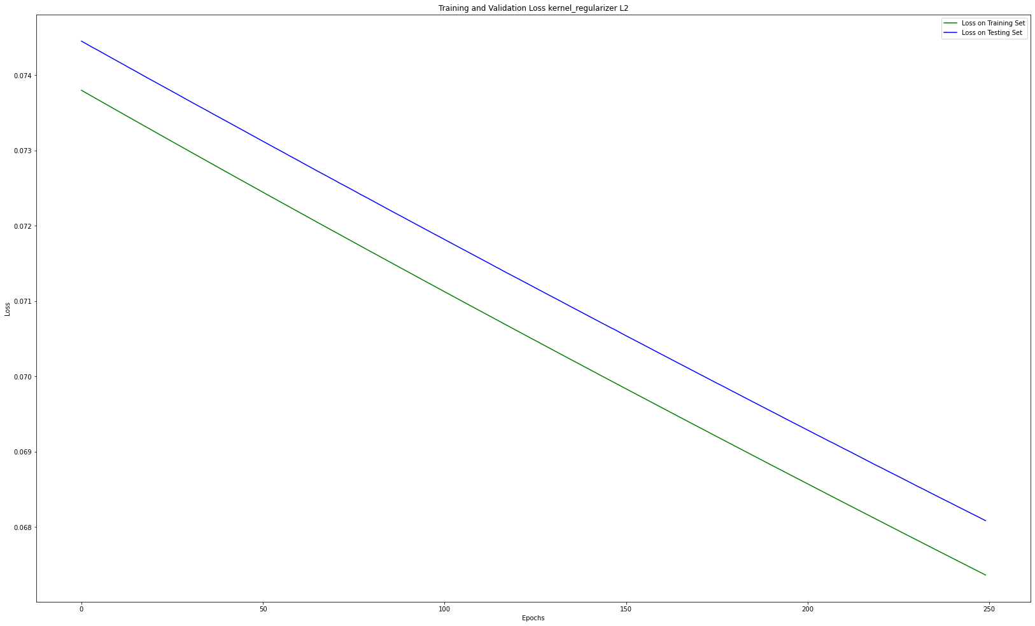

Slide 4
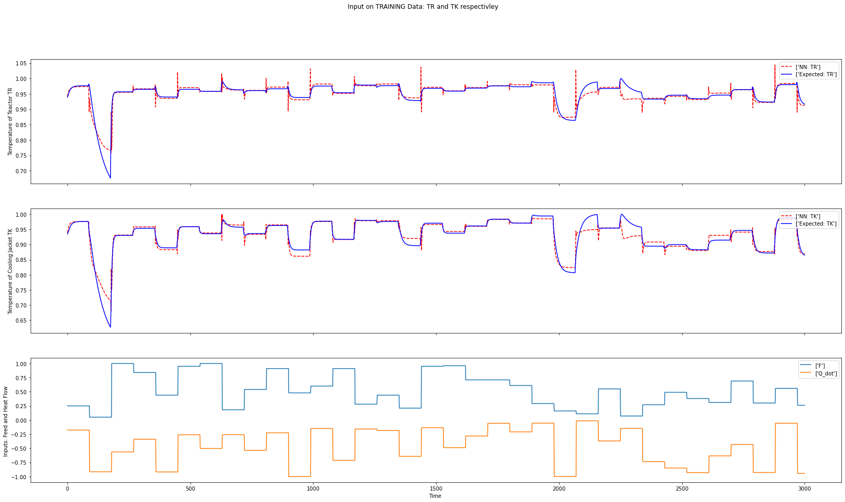

Slide 5
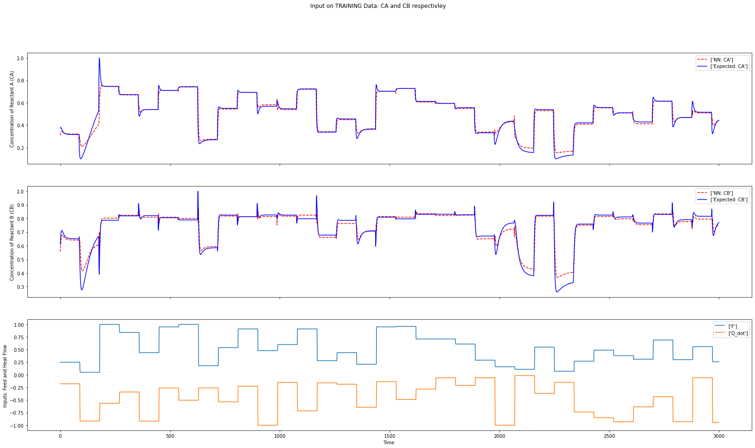

Slide 6
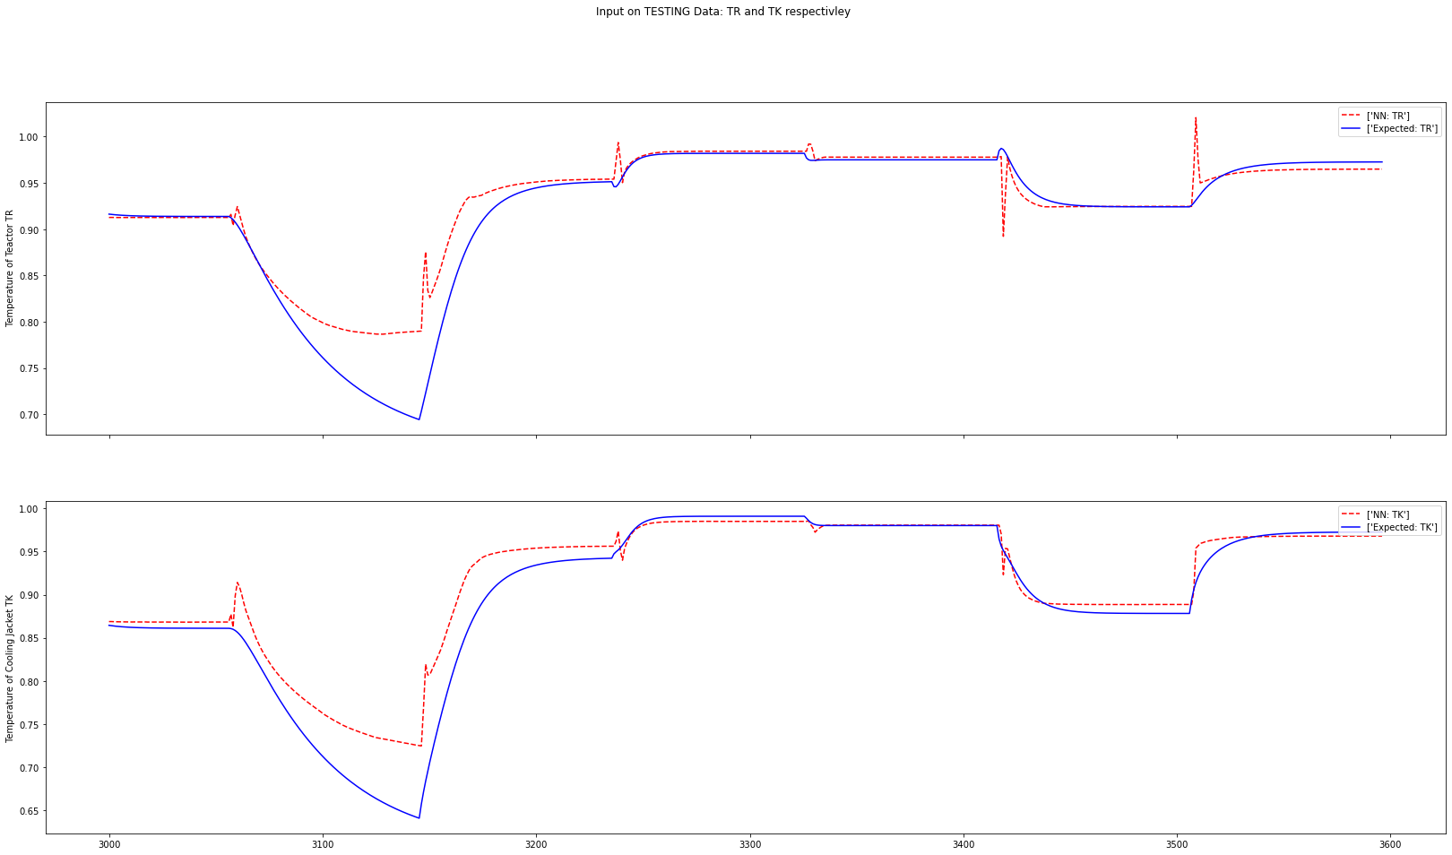

Slide 7
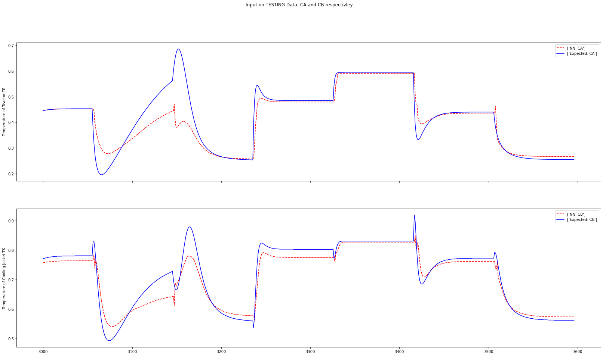

Slide 8
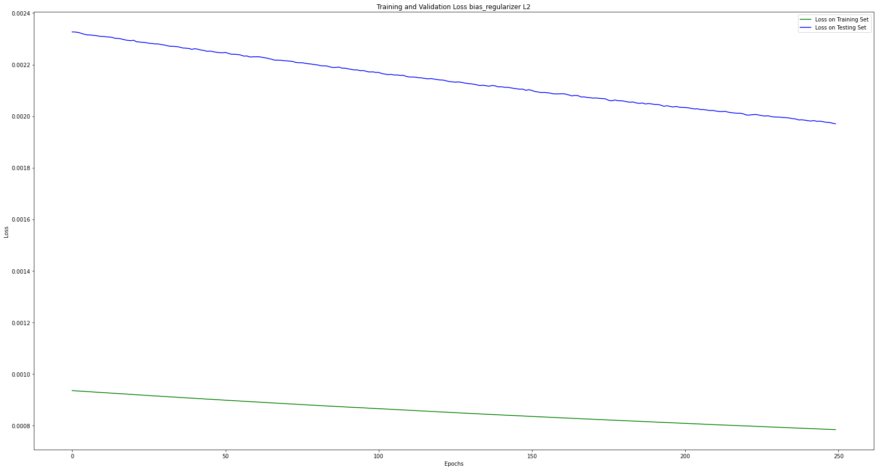

Slide 9
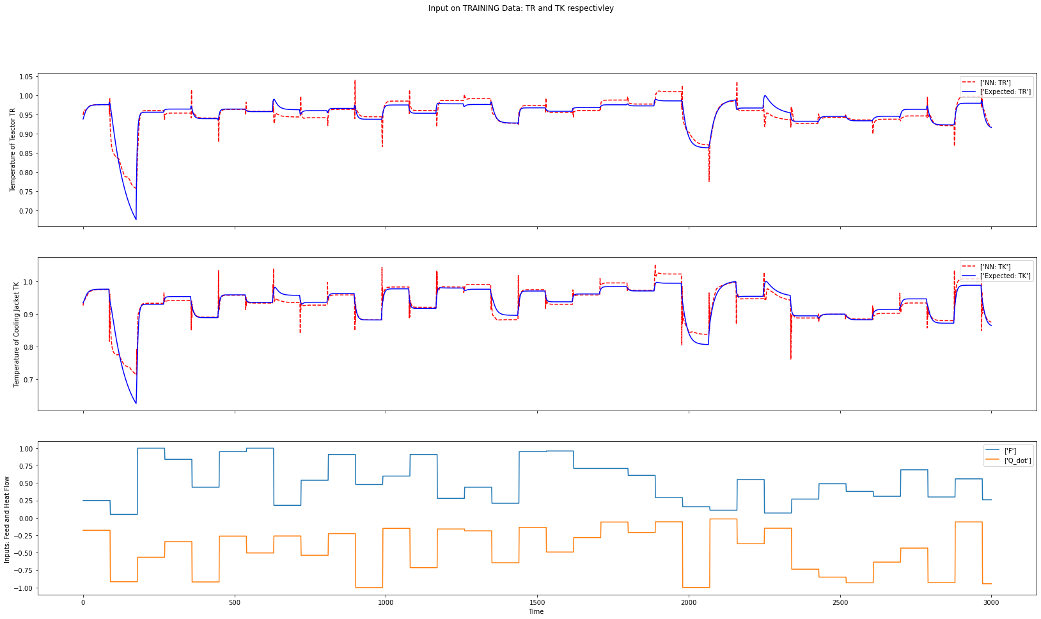

Slide 10
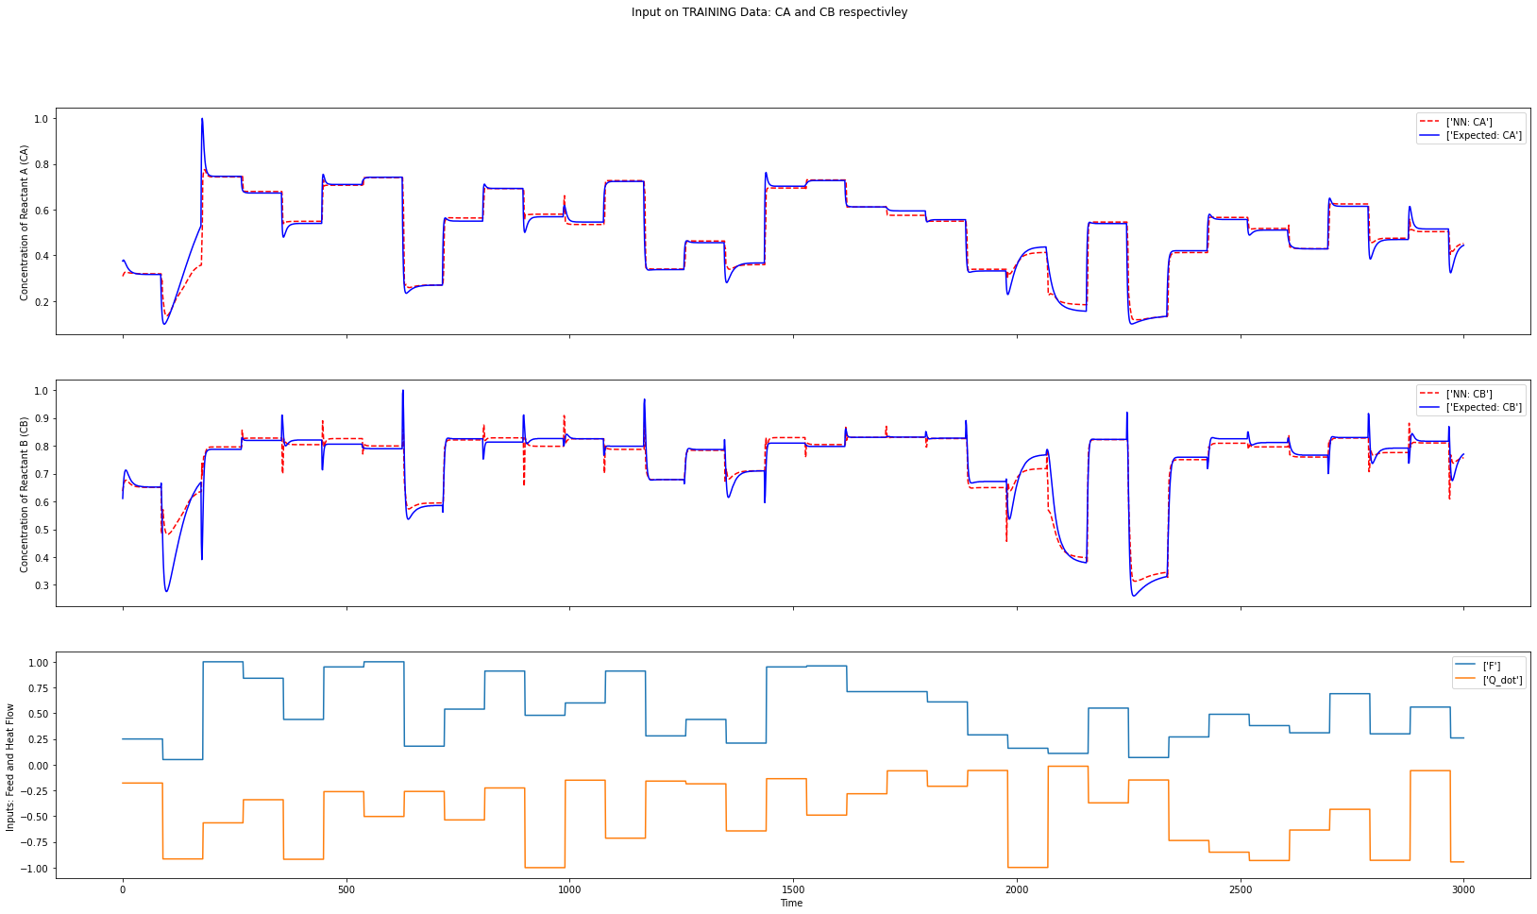

Slide 11
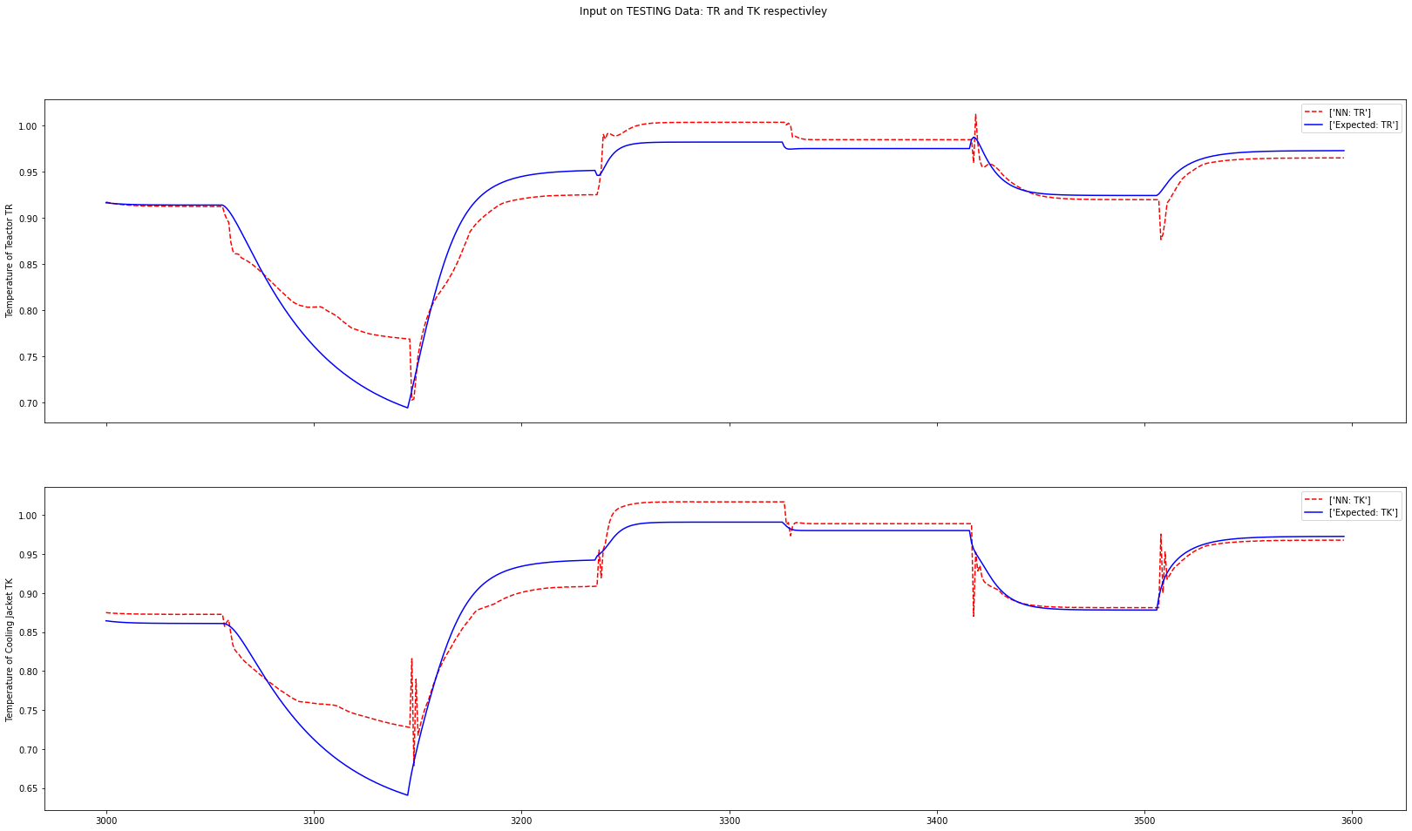

Slide 12
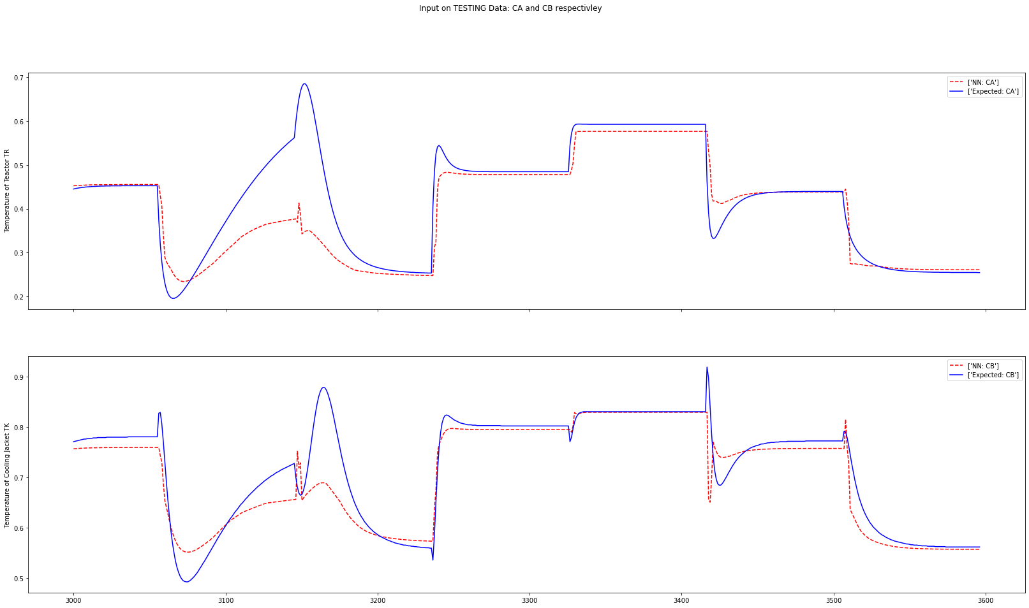

Slide 13
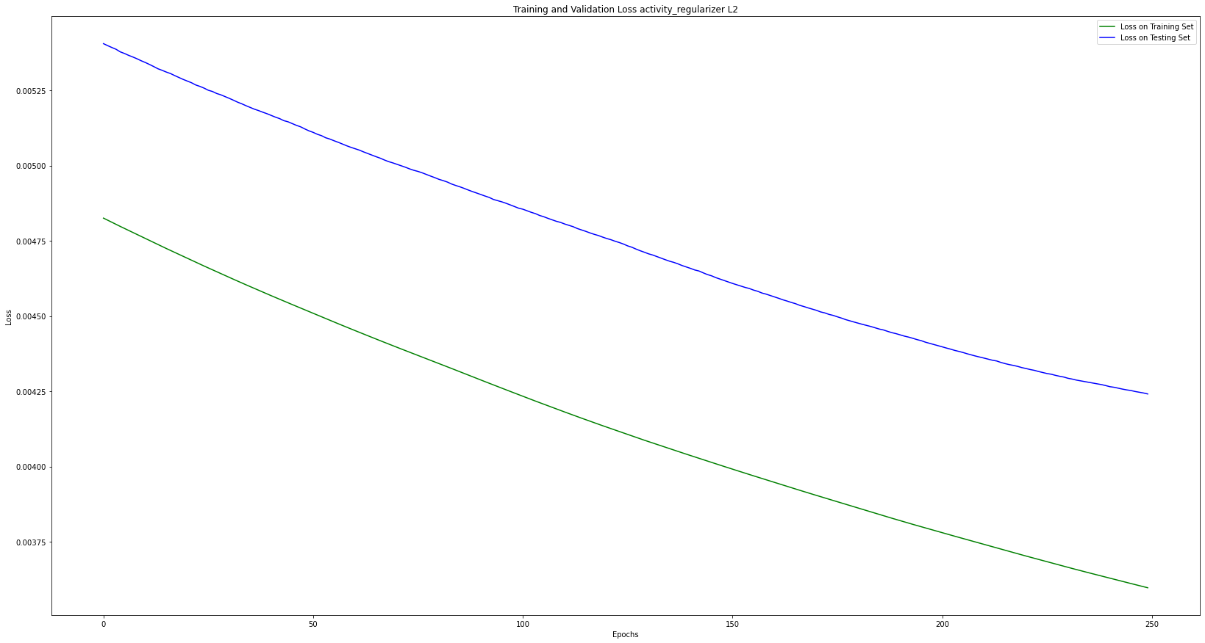

Slide 14
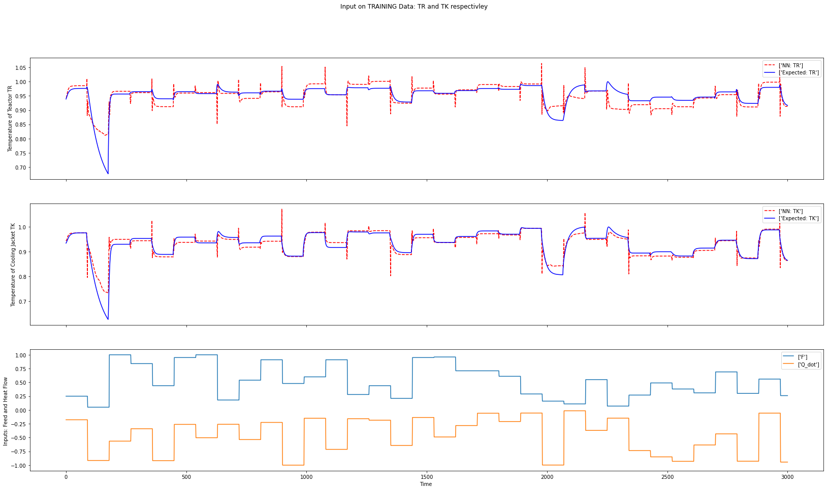

Slide 15
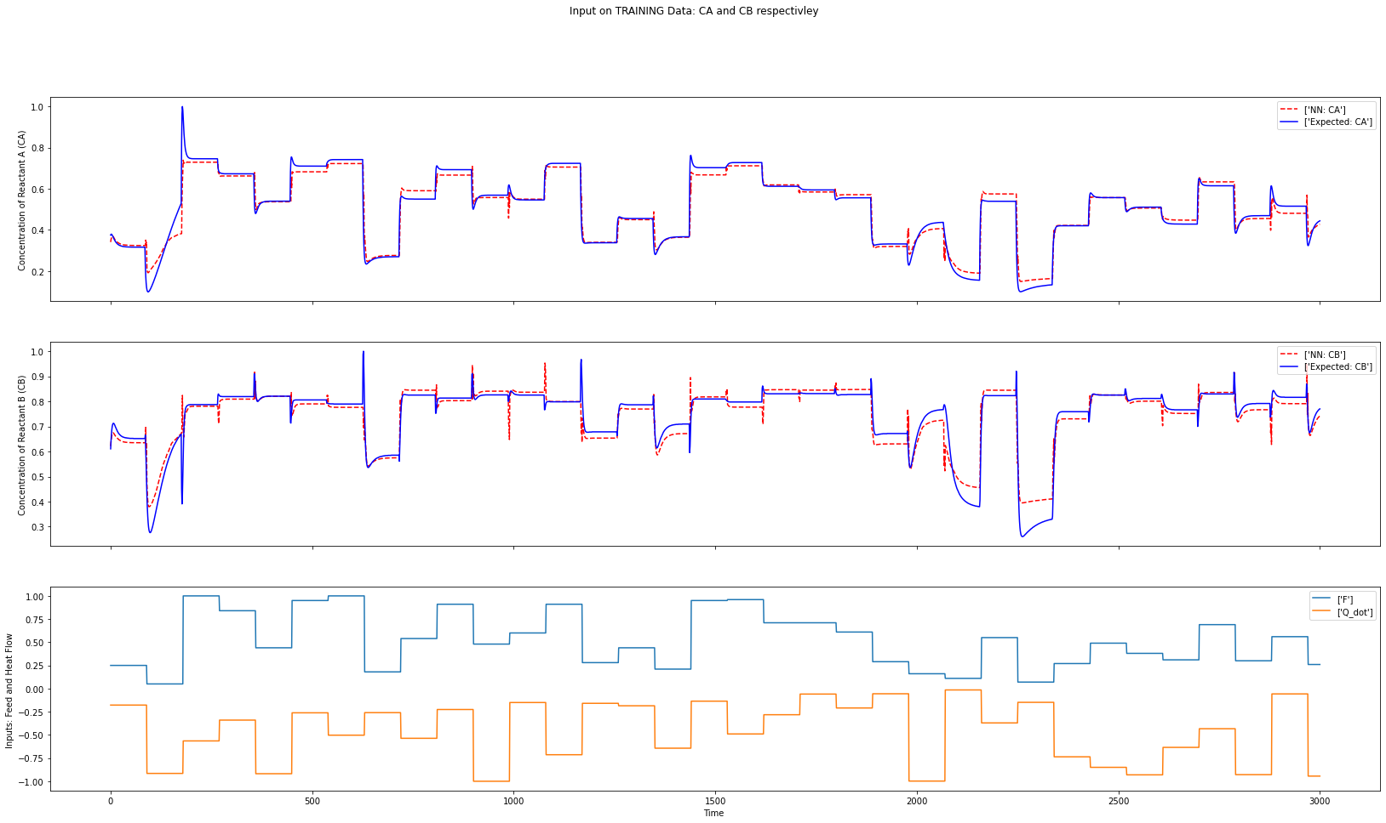

Slide 16
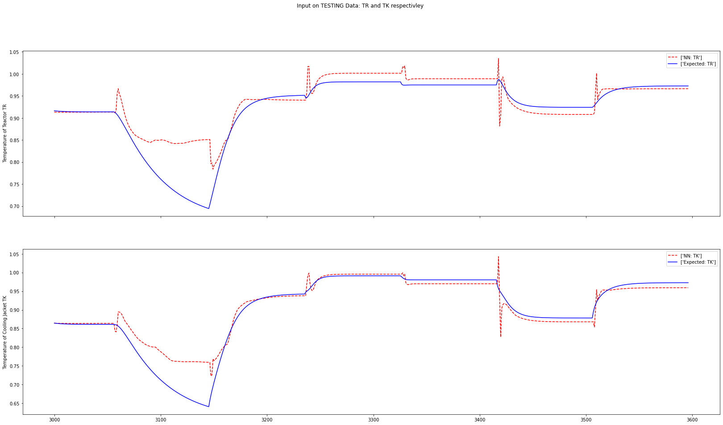

Slide 17
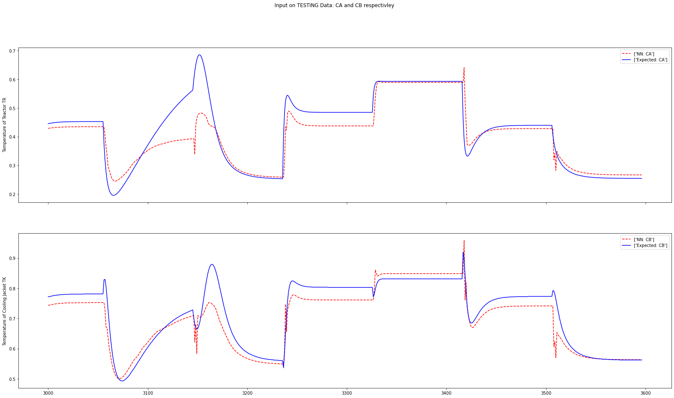

Slide 18
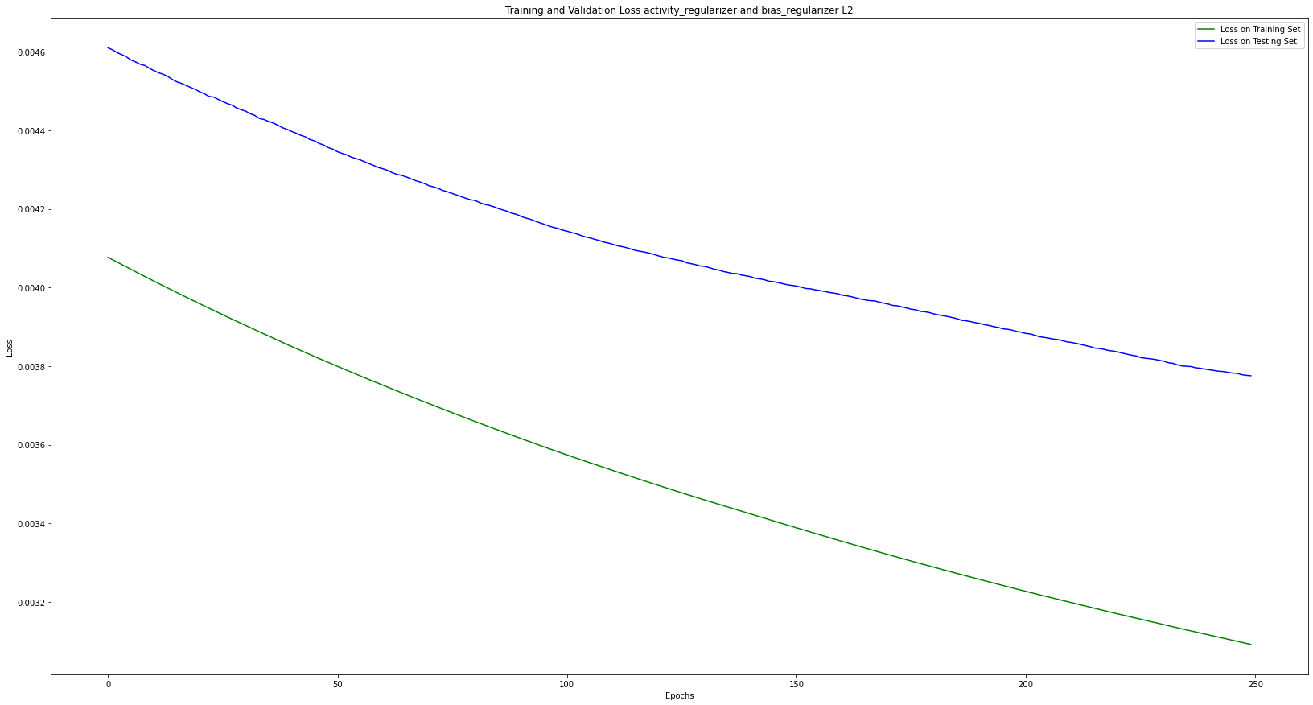

Slide 19
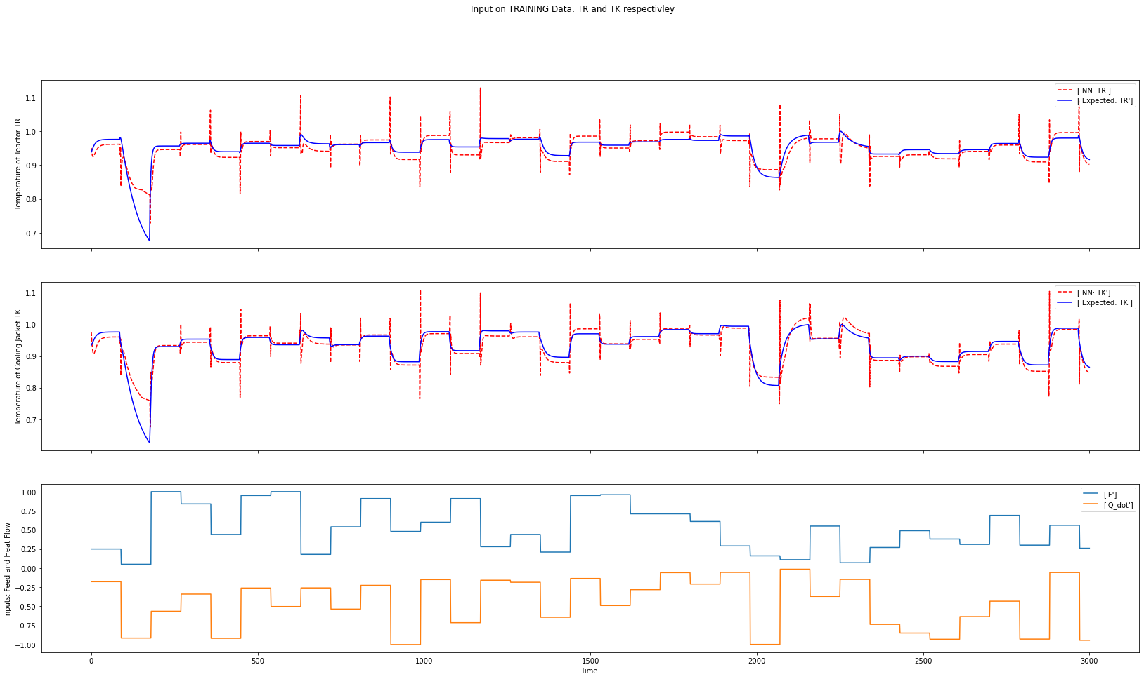

Slide 20
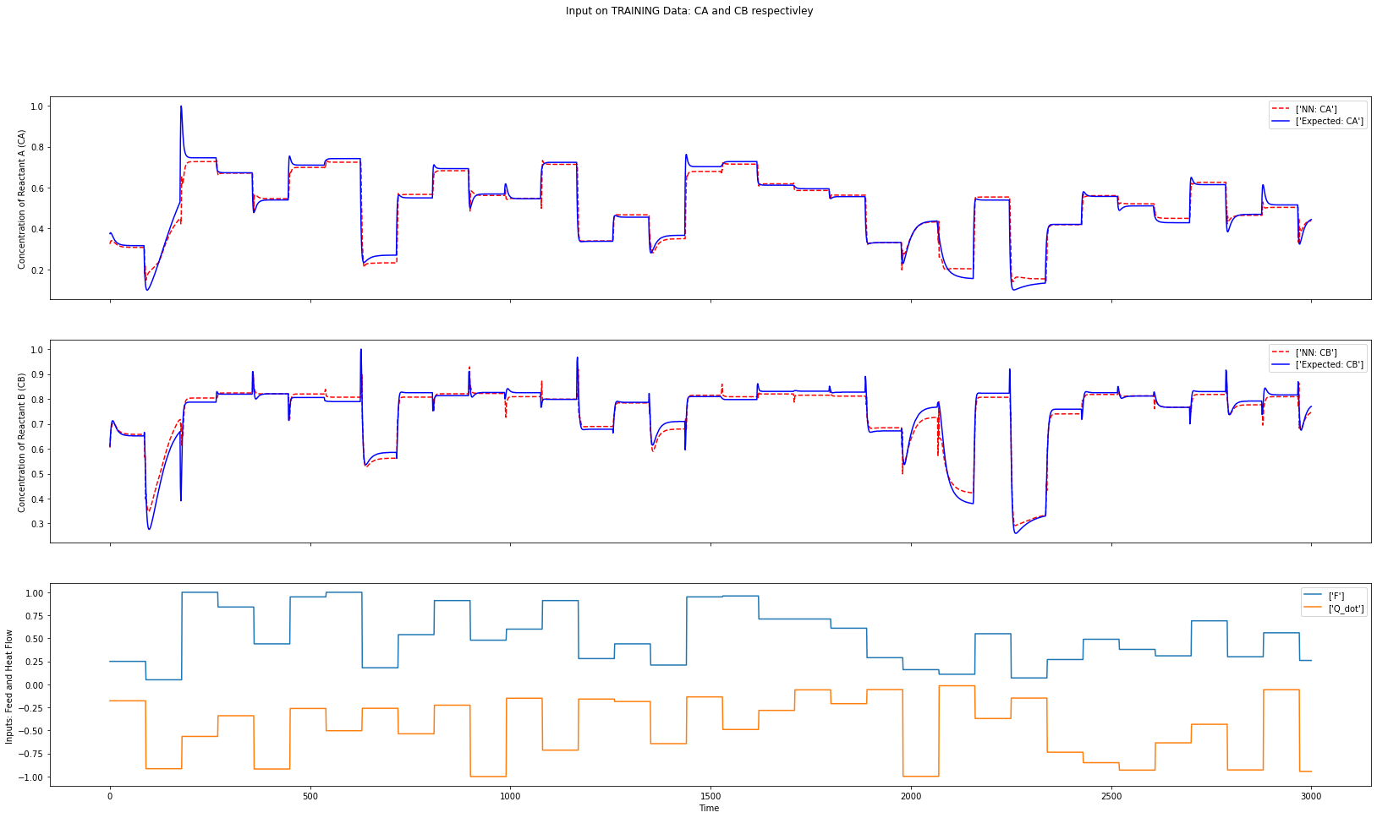

Slide 21
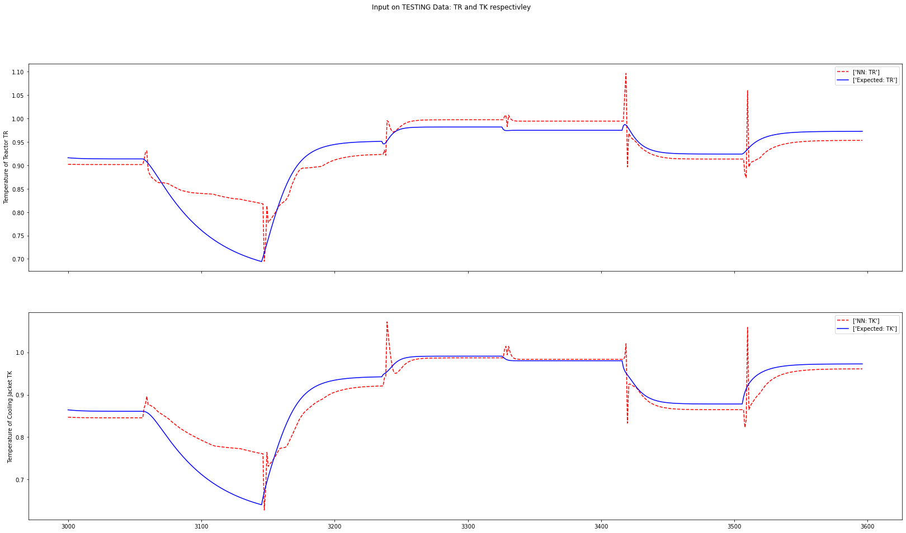

Slide 22
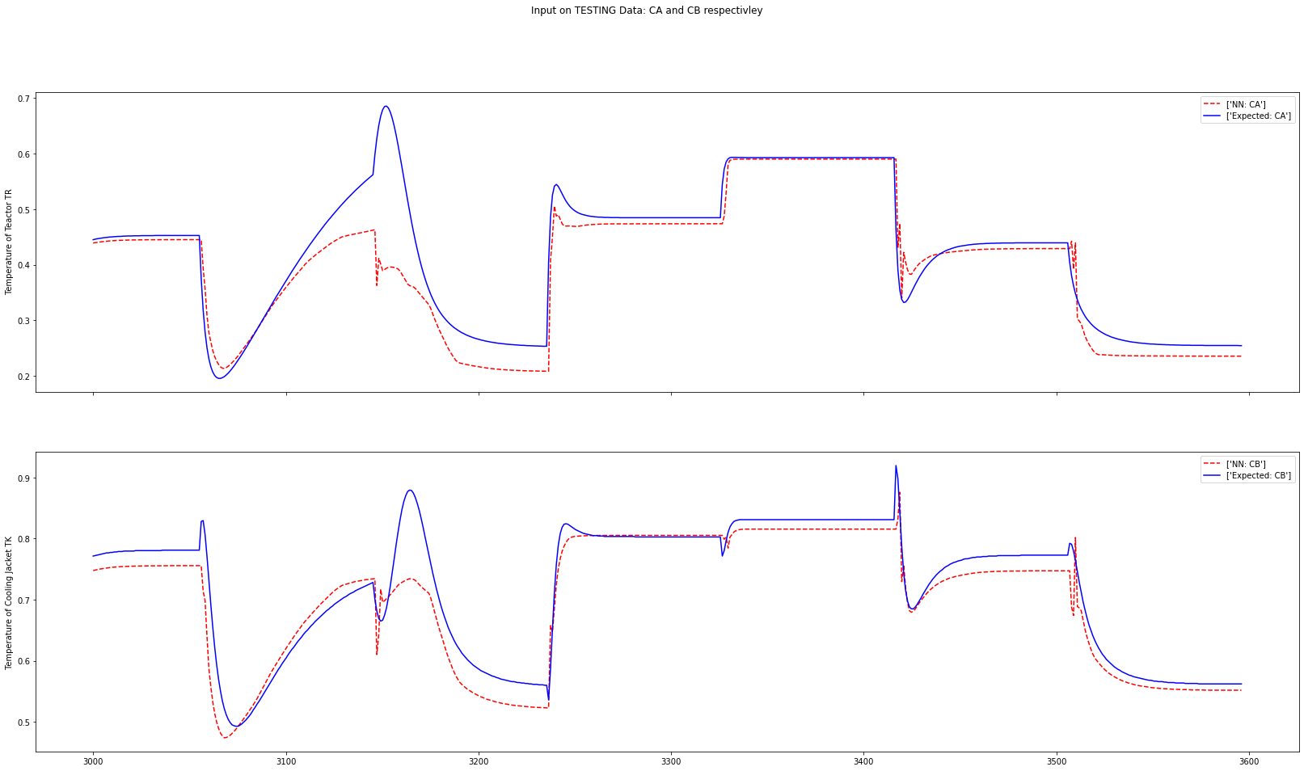

Slide 23
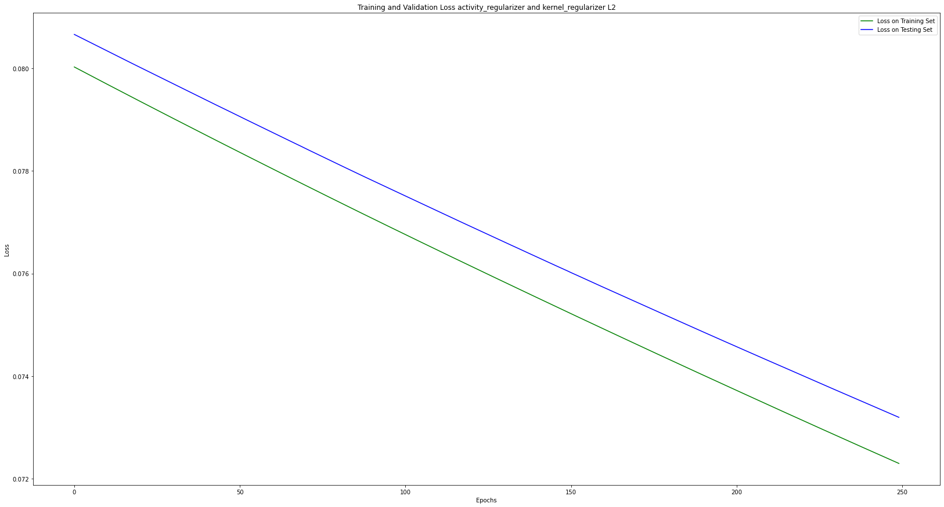

Slide 24
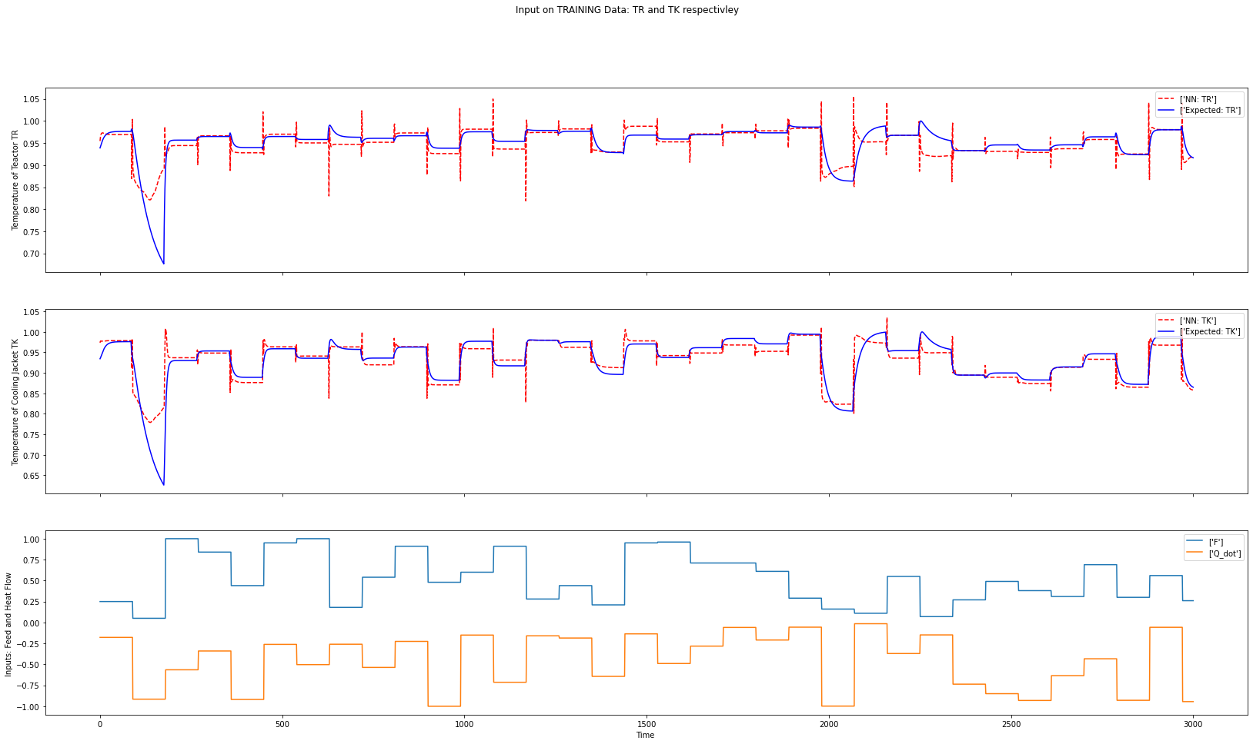

Slide 25
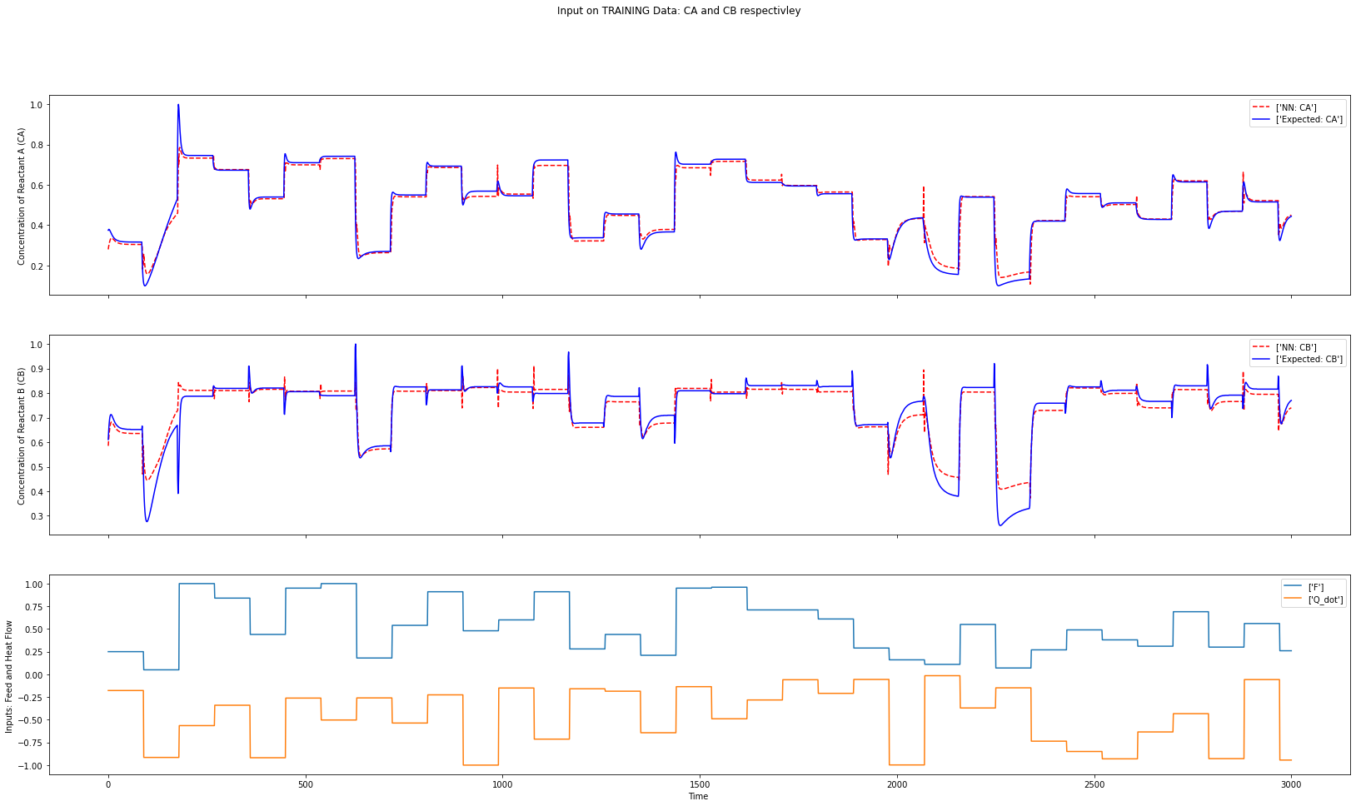

Slide 26
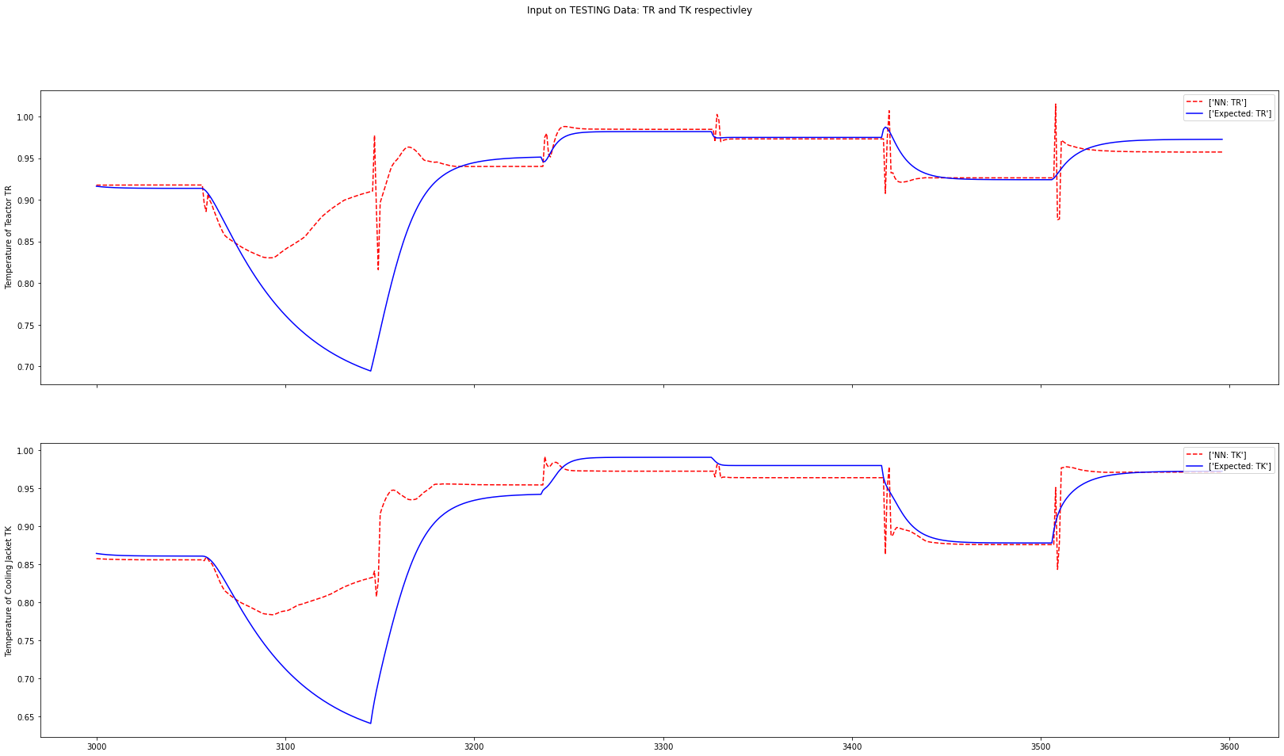

Slide 27
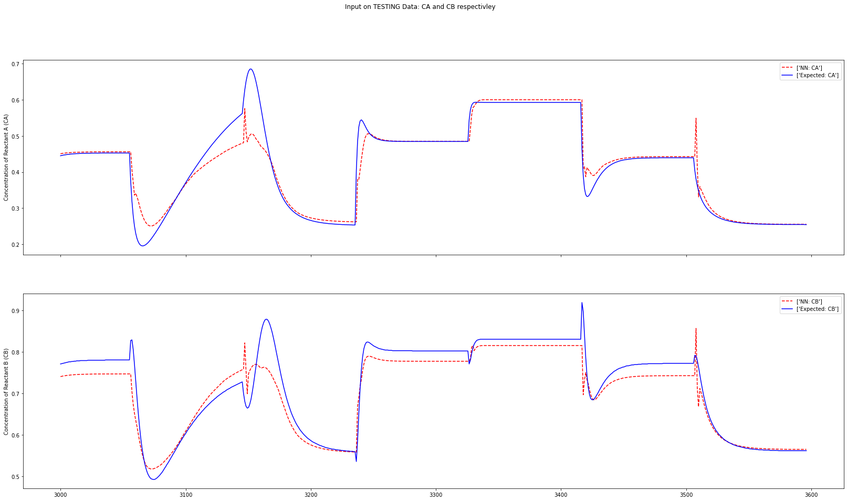

Slide 28
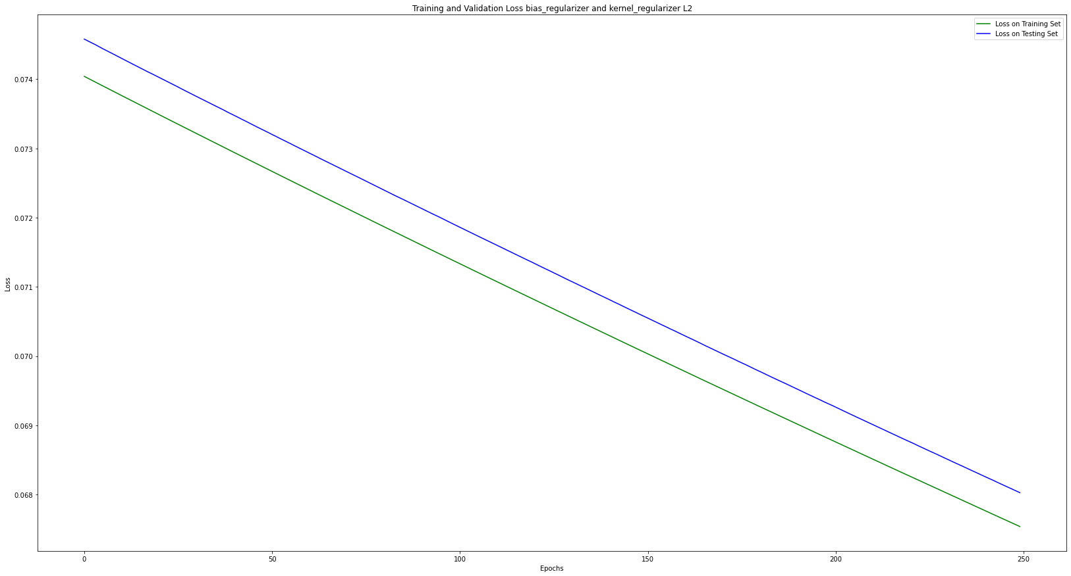

Slide 29
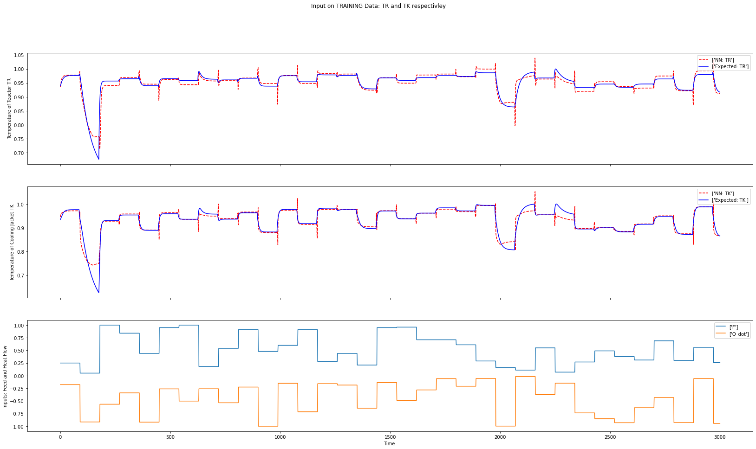

Slide 30
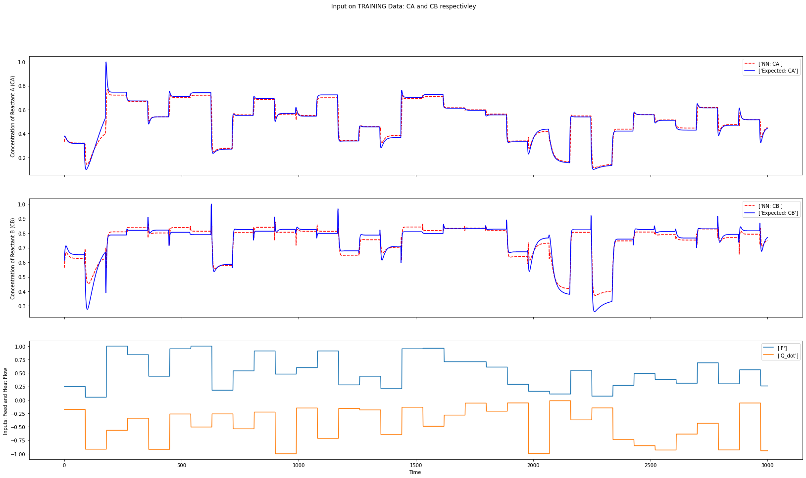

Slide 31
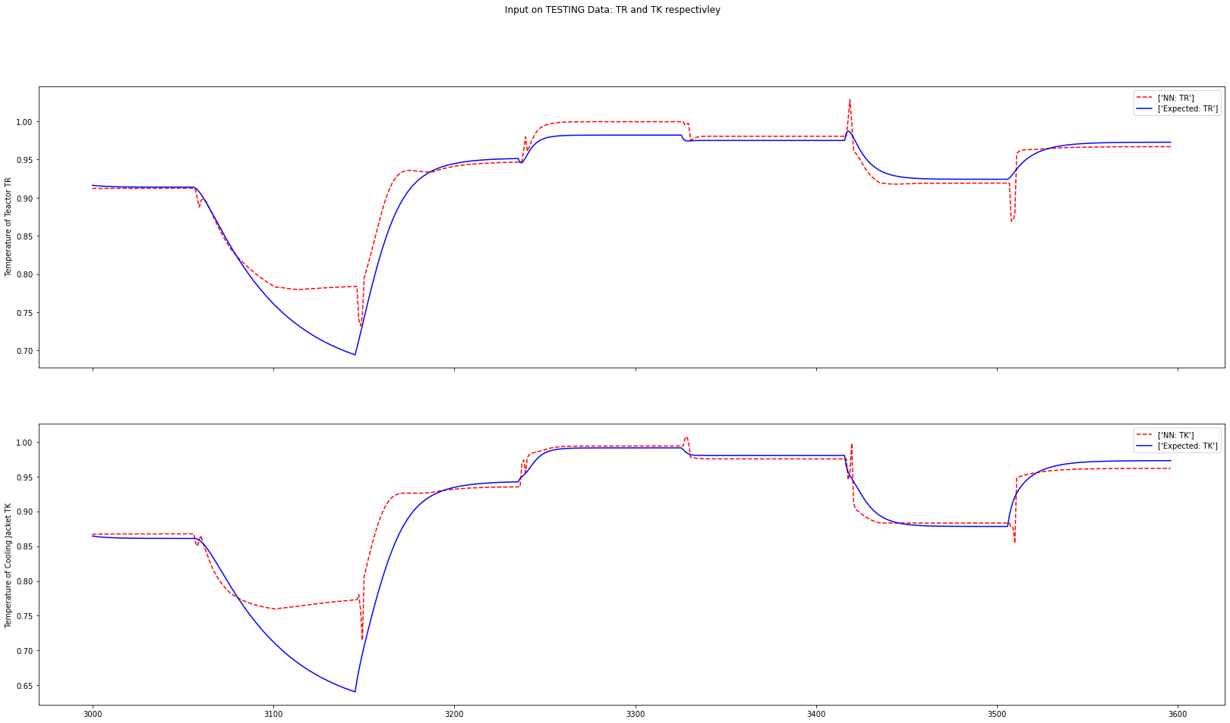

Slide 32
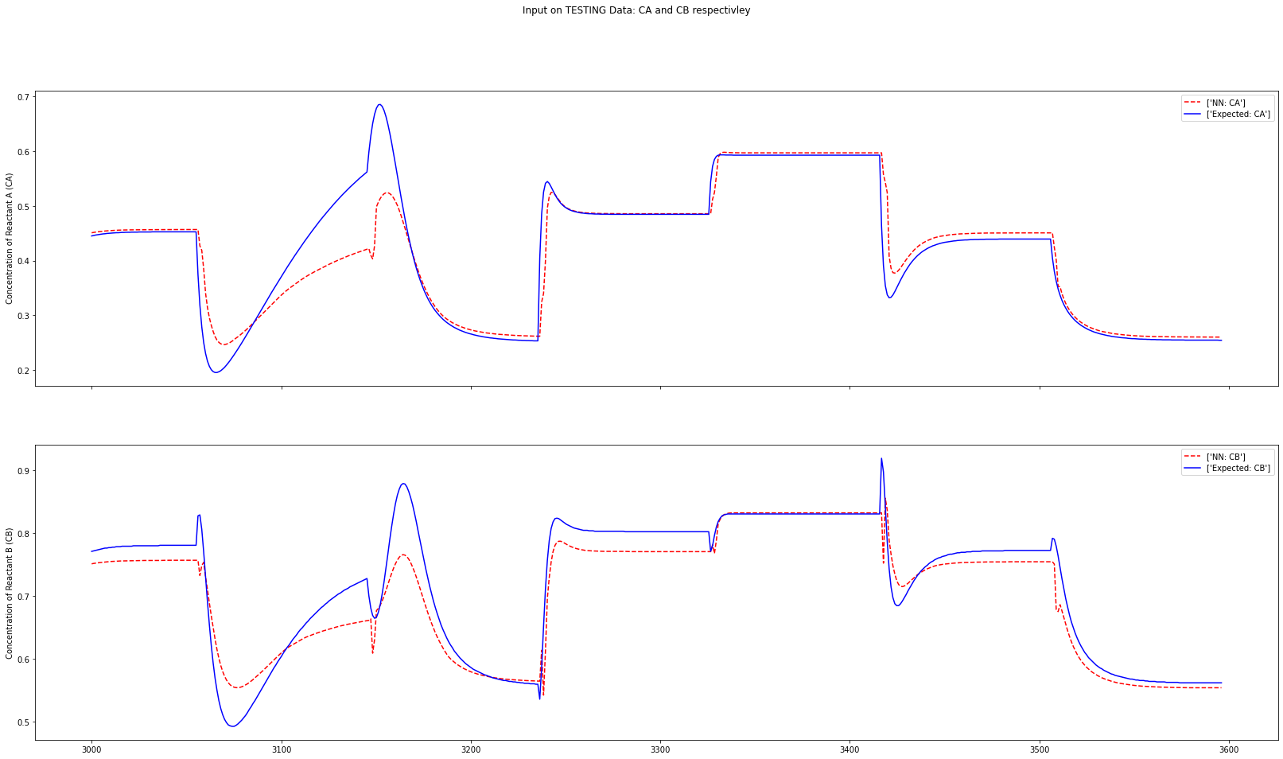

Slide 33
L1

Slide 34
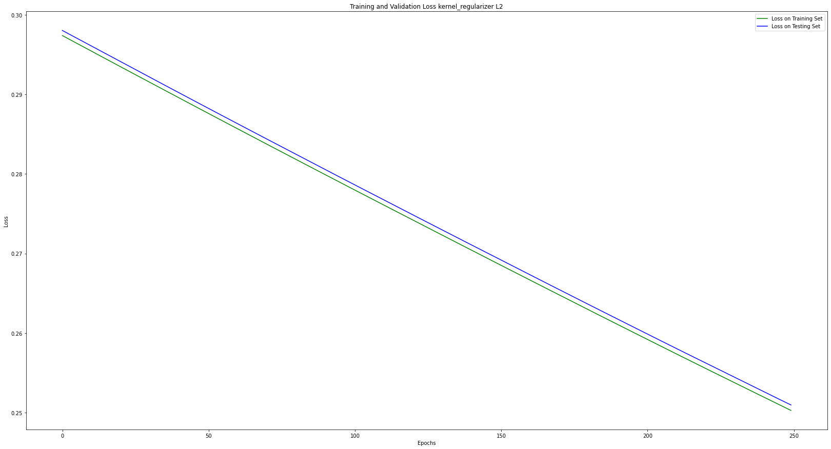

Slide 35
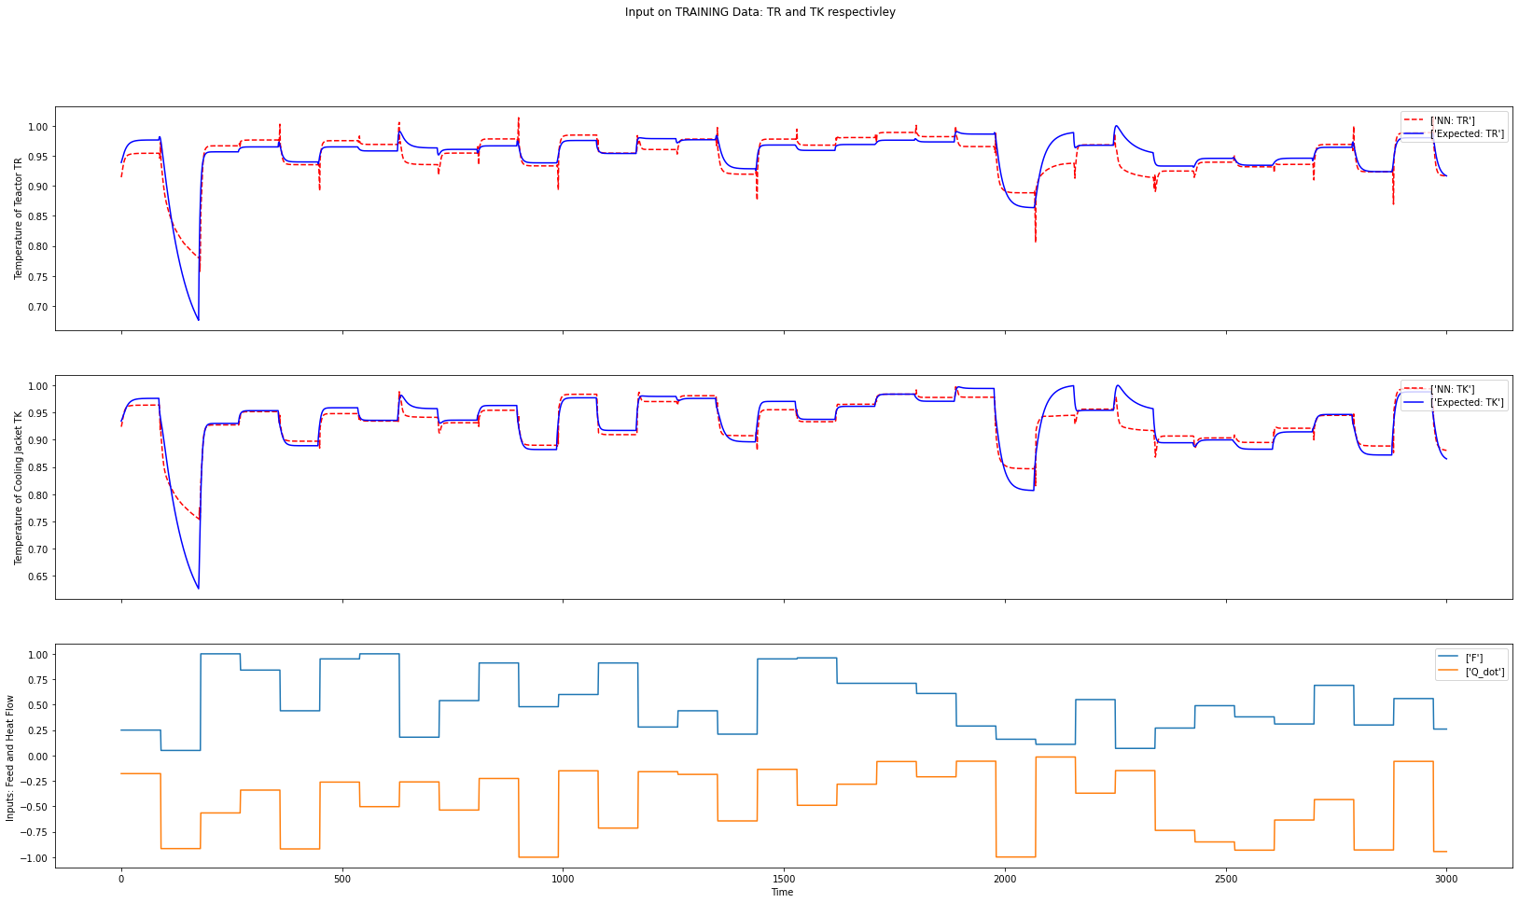

Slide 36
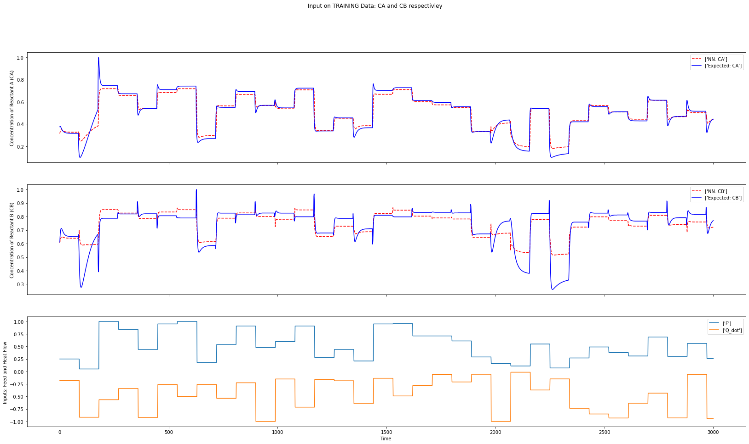

Slide 37
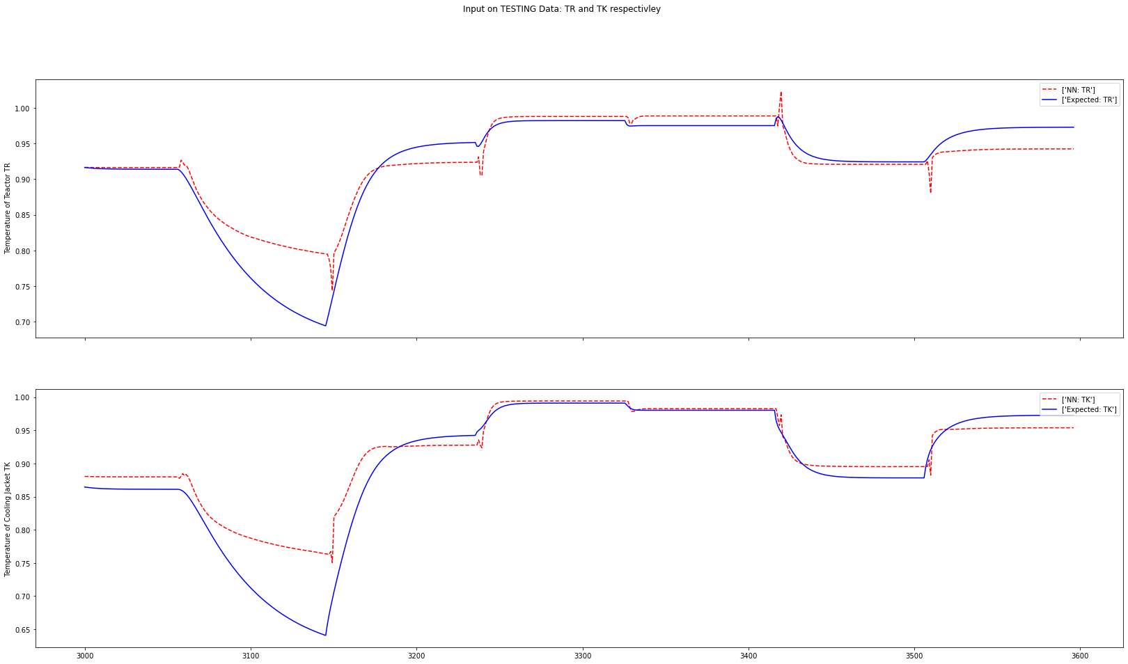

Slide 38
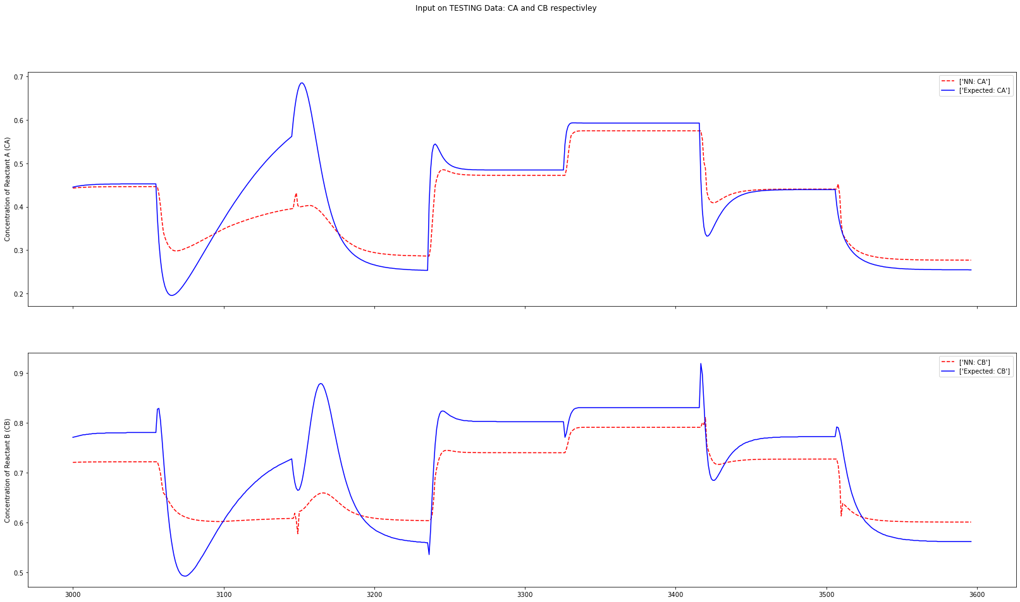

Slide 39
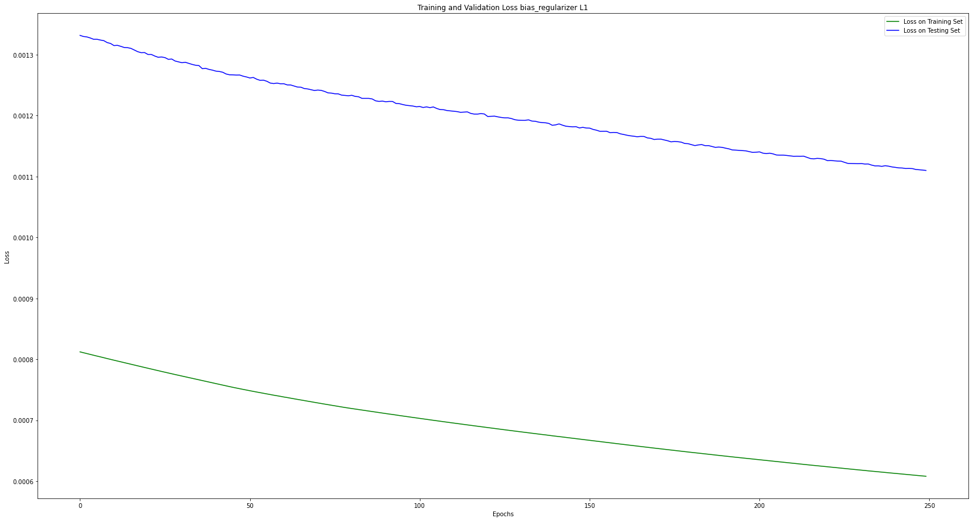

Slide 40
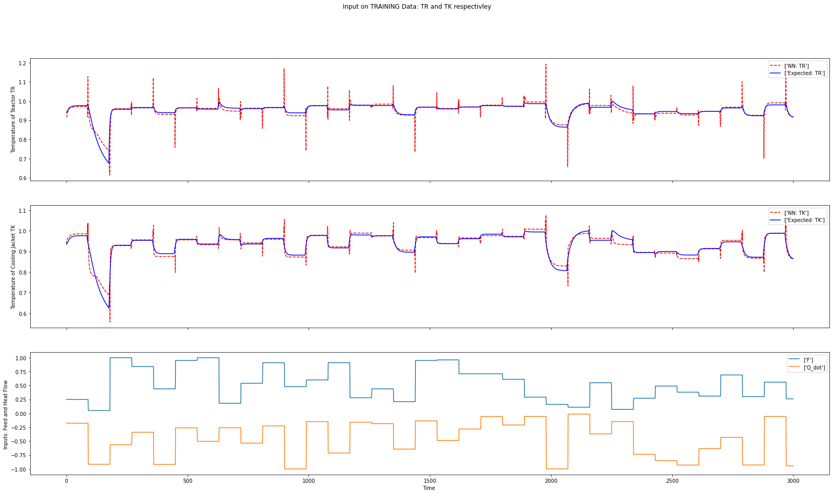

Slide 41
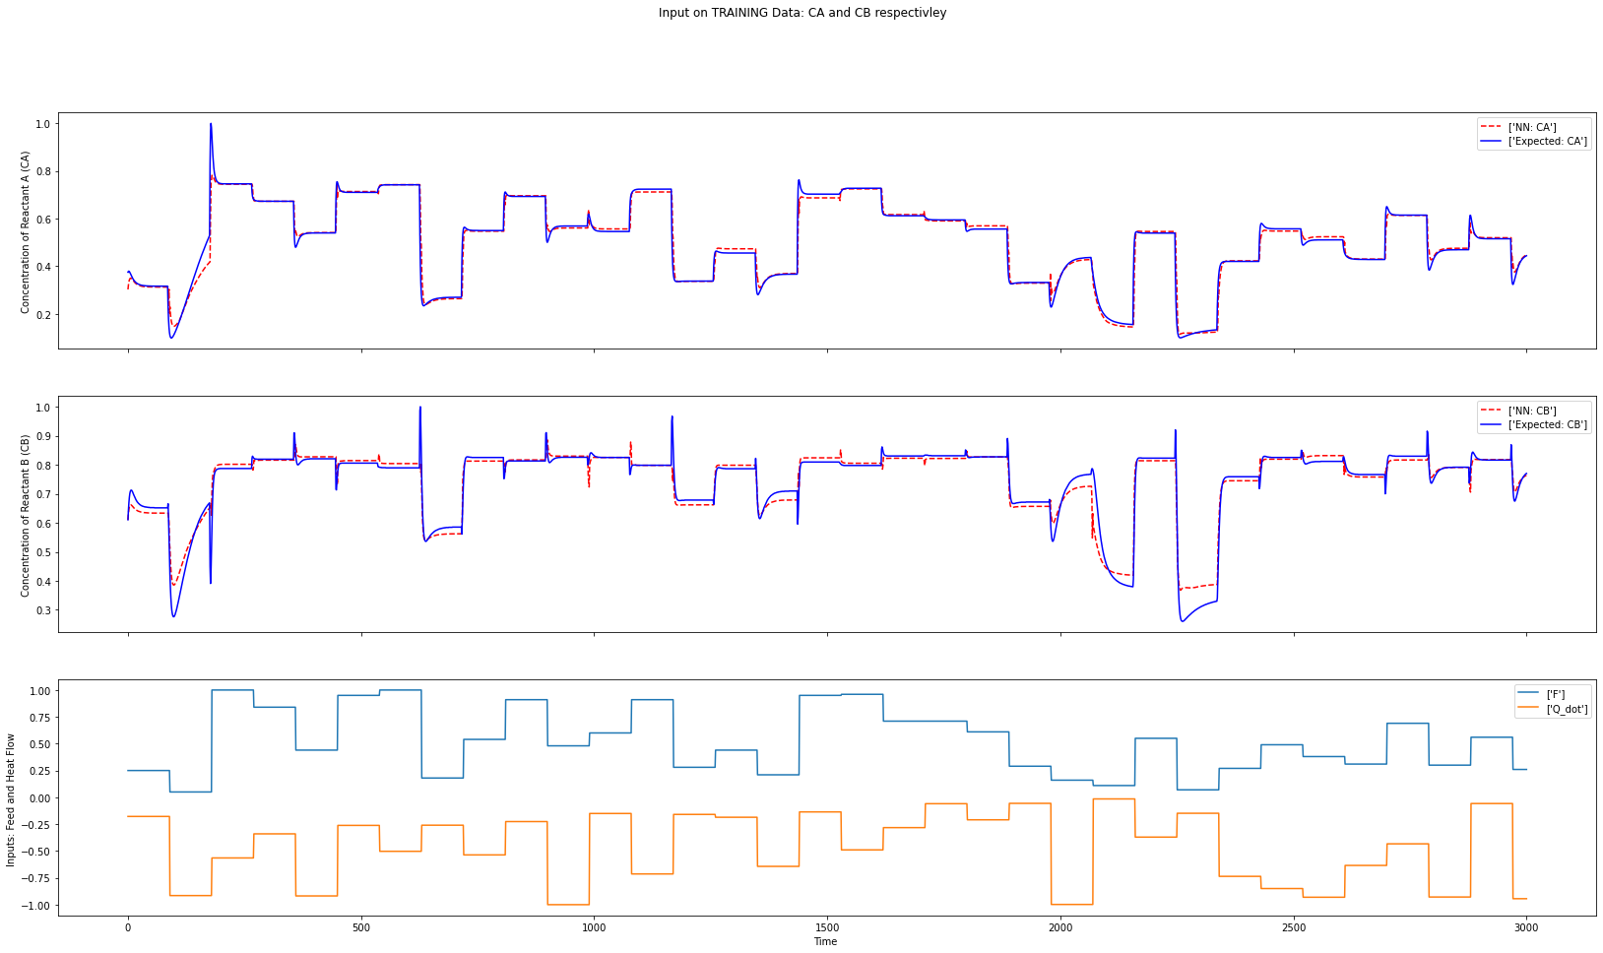

Slide 42
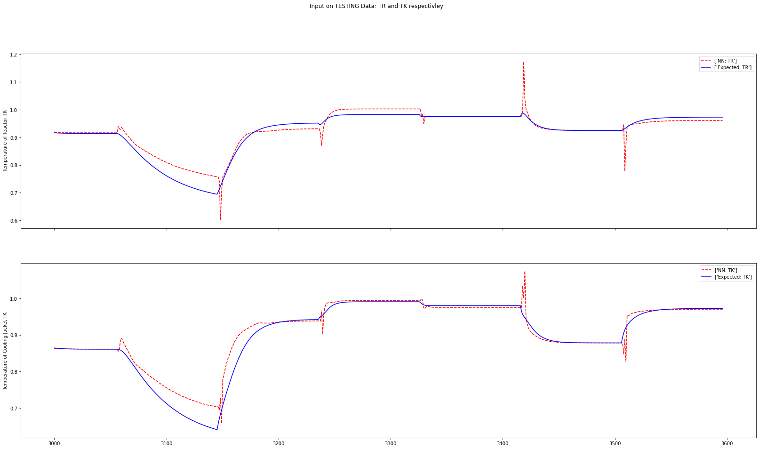

Slide 43
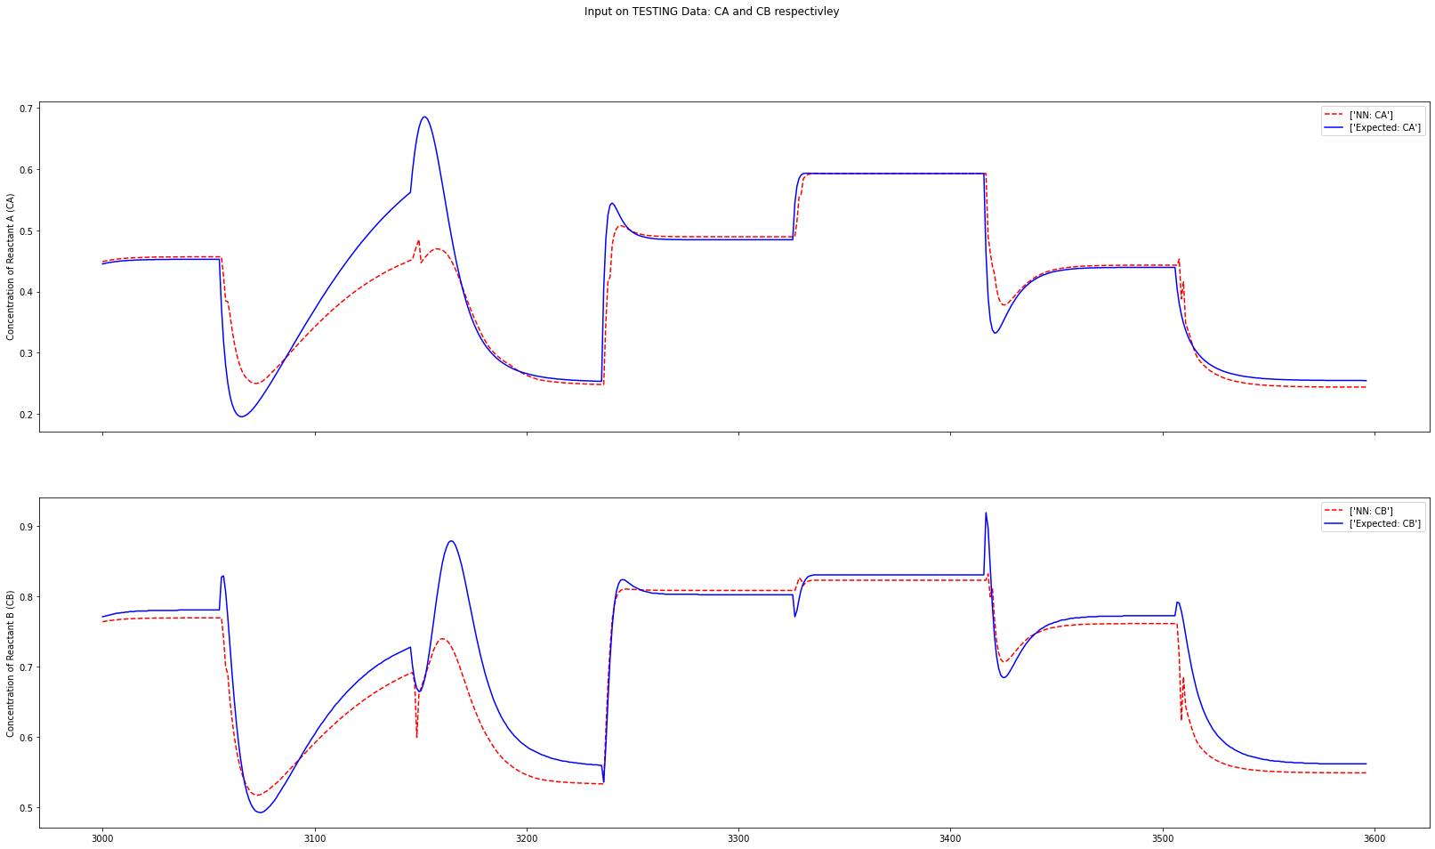

Slide 44
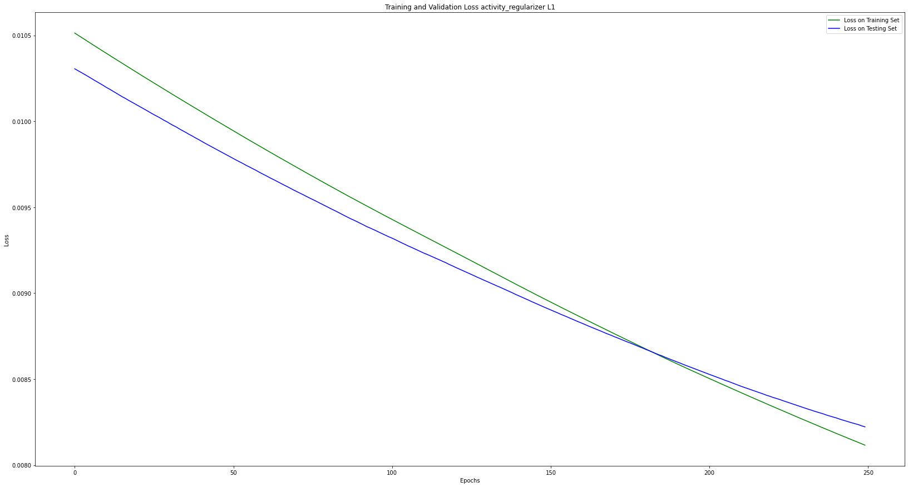

Slide 45
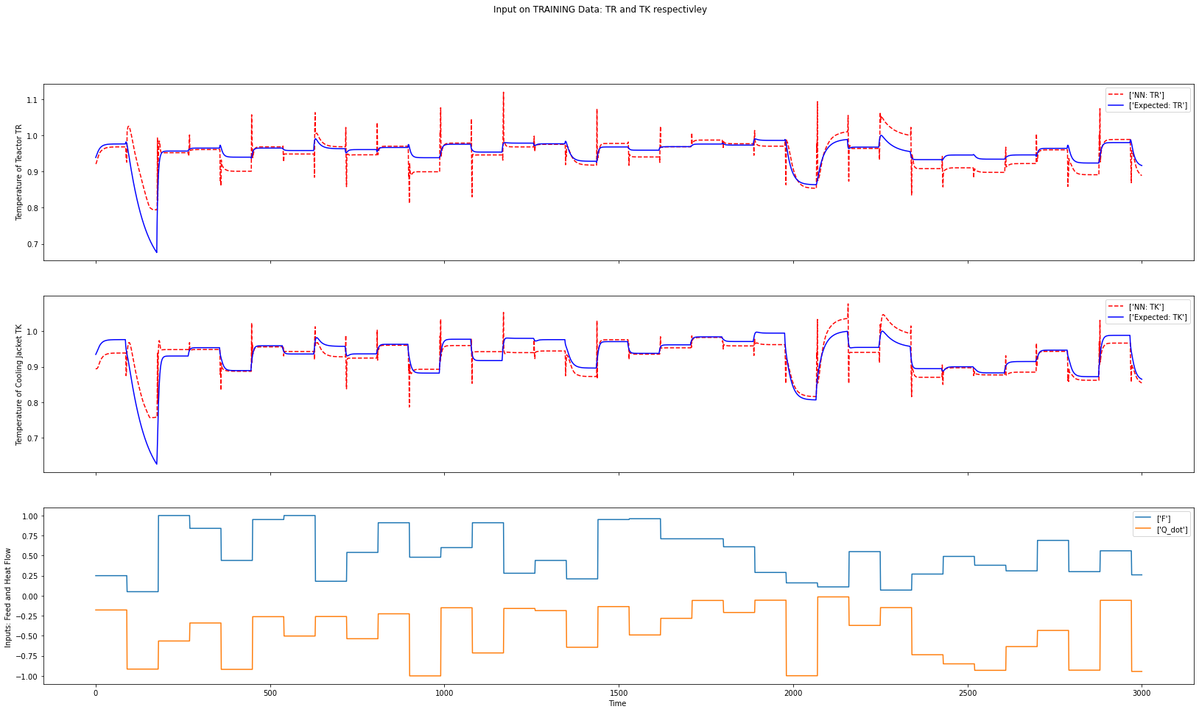

Slide 46
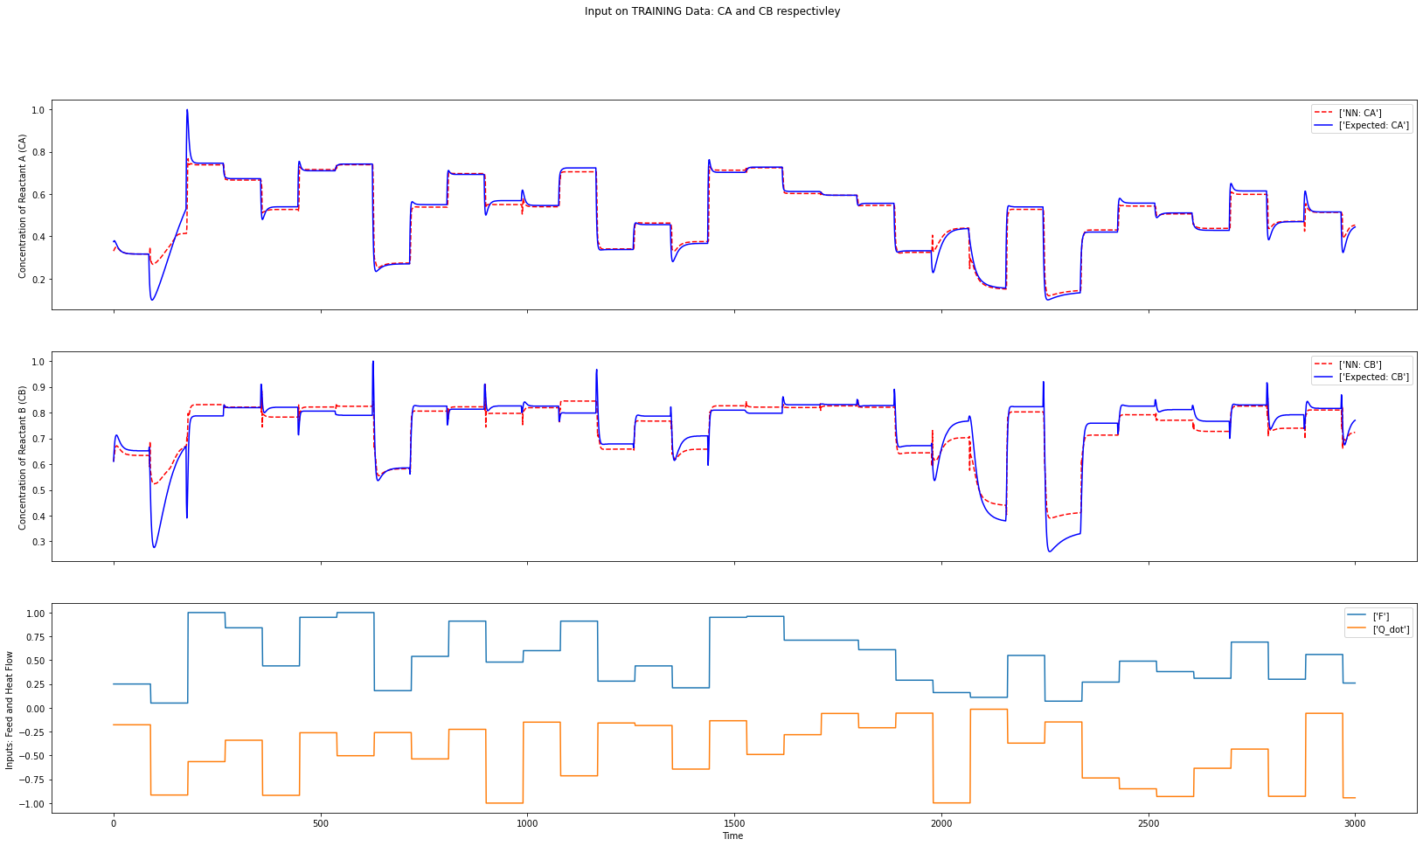

Slide 47
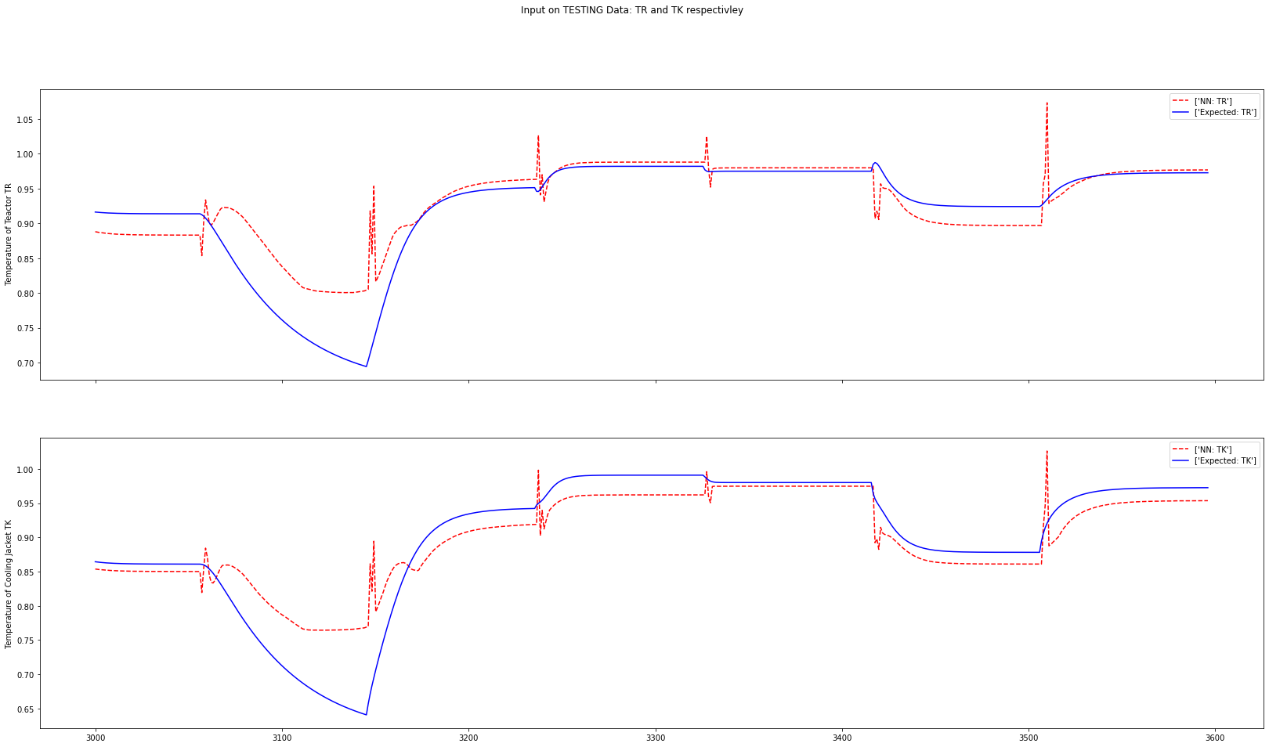

Slide 48
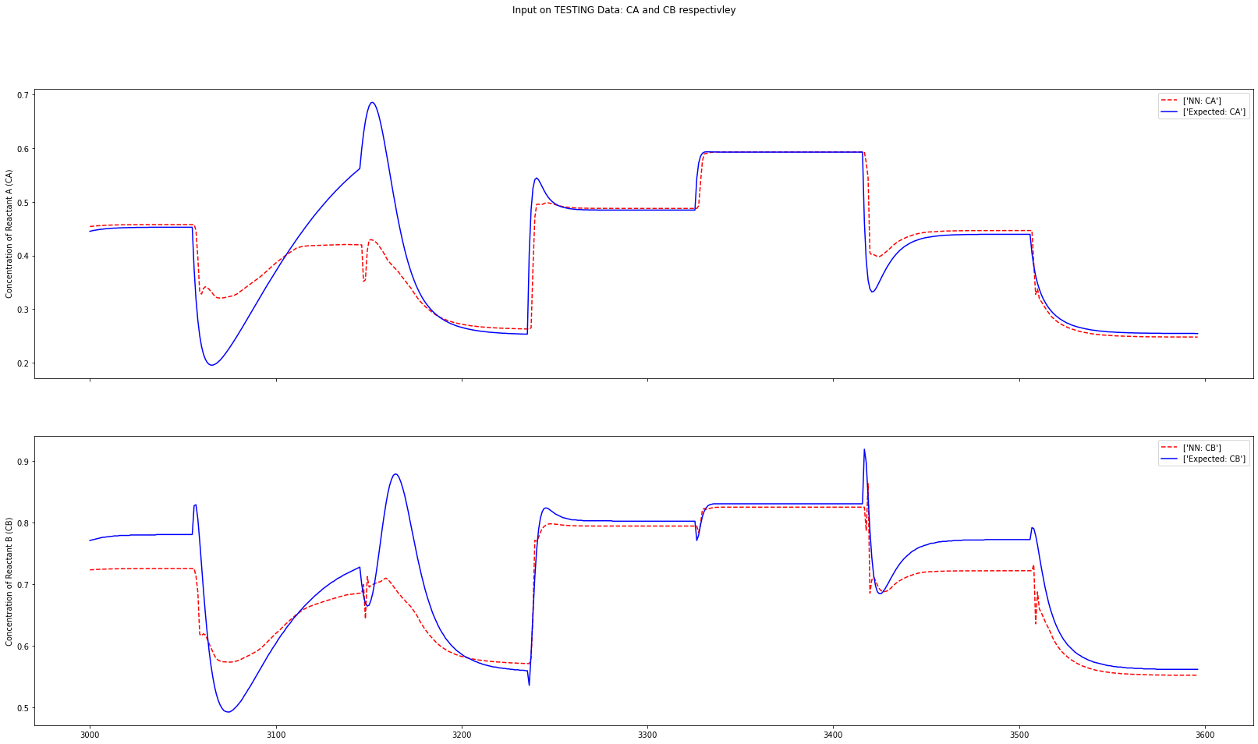

Slide 49
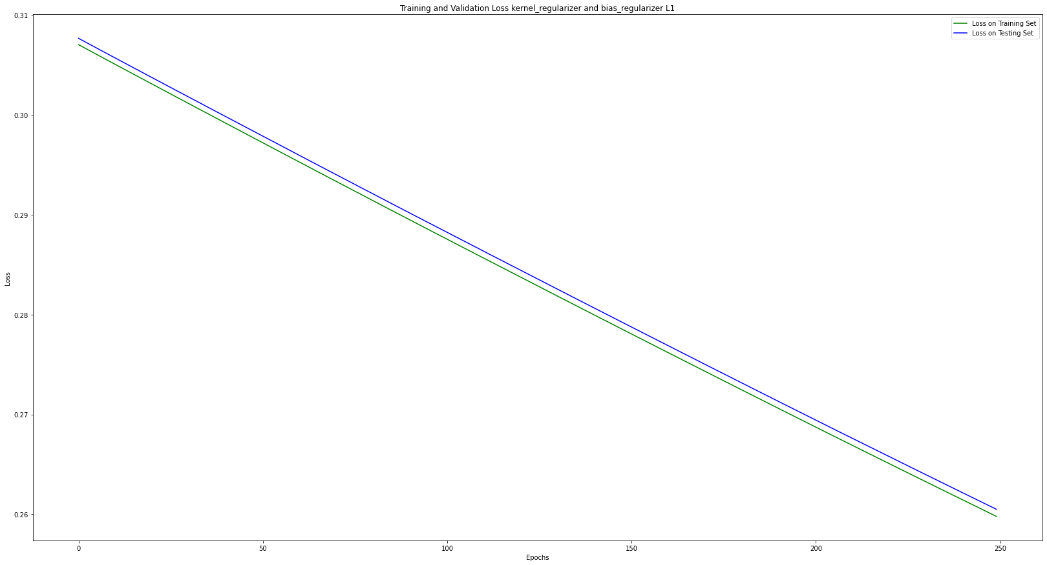

Slide 50
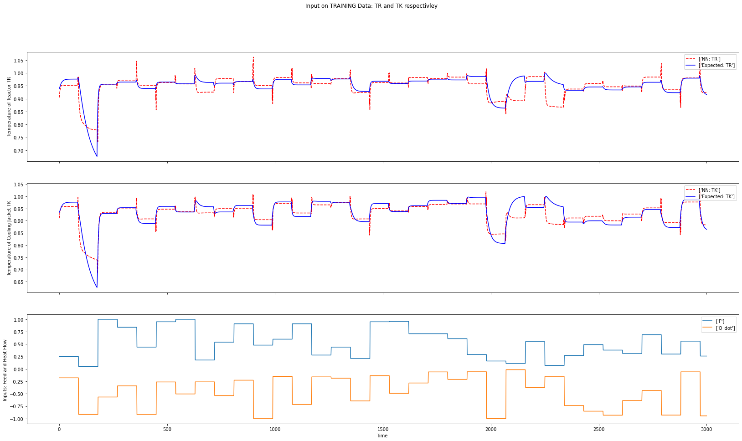

Slide 51


Slide 52
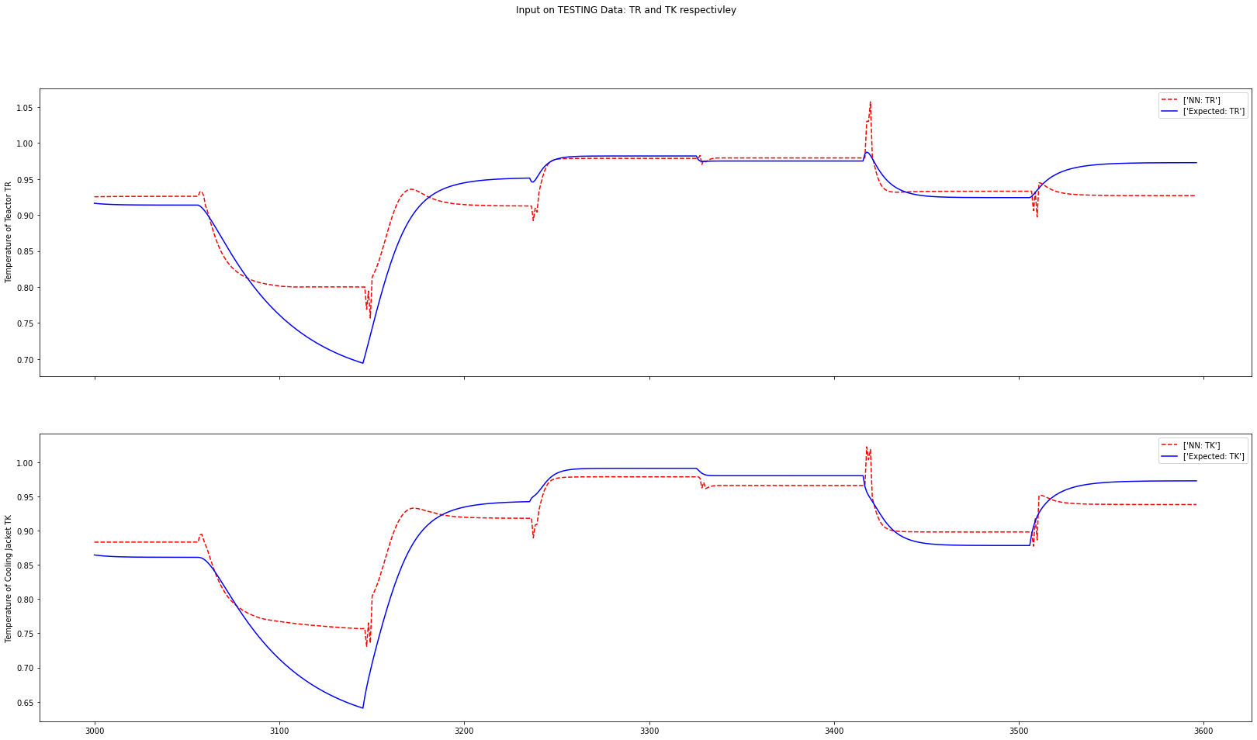

Slide 53
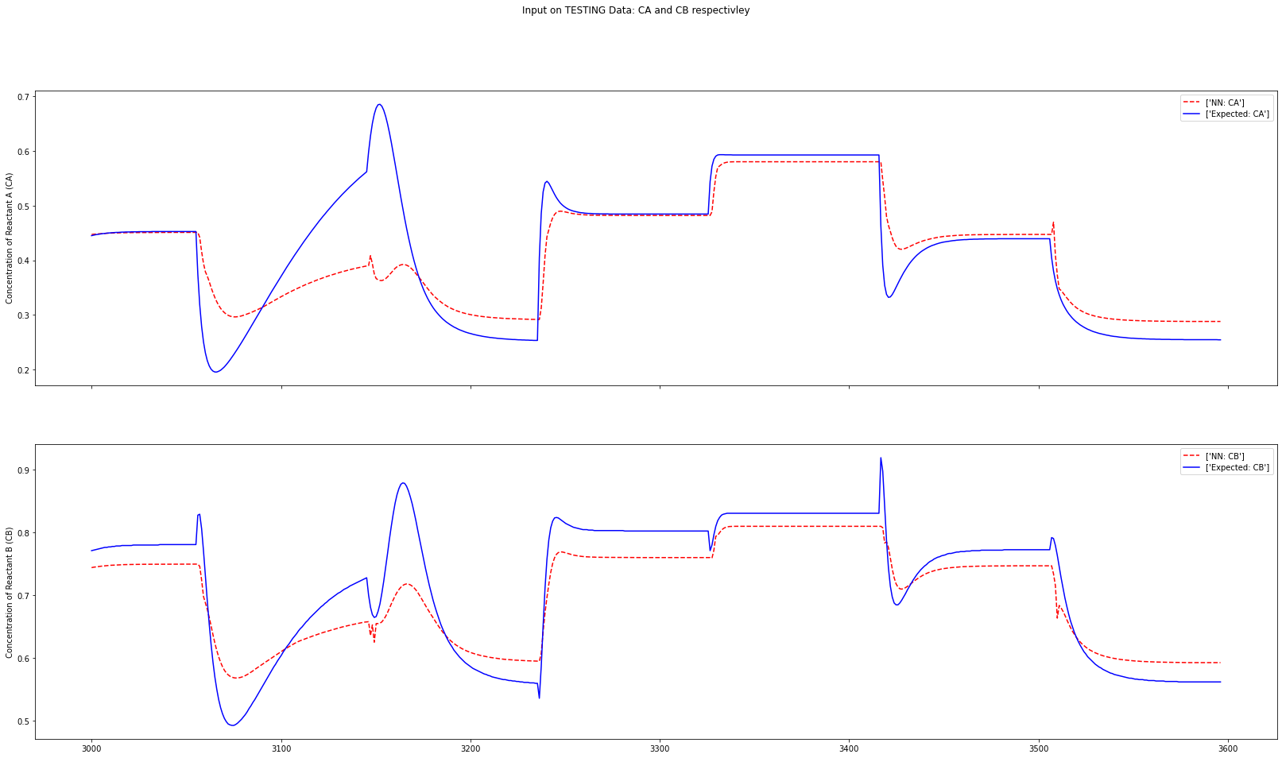

Slide 54


Slide 55


Slide 56


Slide 57


Slide 58


Slide 59


Slide 60


Slide 61


Slide 62


Slide 63


Slide 64
PGNN

Slide 65


Slide 66


Slide 67


Slide 68


Slide 69


Slide 70


Slide 71


Slide 72


Slide 73
Points for the Mid Term Presentation
Literature Review
Choosing the controller model: CONTINUOUS STIRRED TANK REACTOR (CSTR)
Creating the Random Input Signals and analyzing it with designed controller
Normalization of the inputs and the outputs from the controller
Storing the data in a CSV file to set it up for the basic Machine Learning networks
Basic Machine Learning Network (Vanilla) based on the controller’s output
Closed Loop Simulation and reducing its time period
Starting with the Hyperparameter tuning (initially 5 parameters to work with)
Ananlyzing the Basic Hyperparameters tuning data and enhancing it using a new optimizer (SGD)
Increasing two more Hyperparameters for the basic Vanilla network
PGNN initial test
Conditioning the two constraints on the PGNN network and reviewing its results
Building the Vanilla Network based on the Hyperparameters received
Experimenting with different Regularizers to see its impact on the Vanilla Network

